Slide 1
Examples of Specific Laser Systems
Gas Lasers
  CO₂ (9-10 μm), High Power
  He:Ne (632 nm) , Ar (ion) Laser (520 nm)
  Excimer (UV) Lithography
Solid-State Lasers
Nd:YAG , Ti:Sapphire (Ultrafast Revolution)
Fiber Lasers (Rare-Earth Doped Fiber Lasers)
Yb³⁺ (10+ kW), Tm³⁺ , Ho³⁺ (2 μm), Er³⁺ (1.5 μm)
Dye Lasers
Chemical Lasers
COIL (7+kW), MIRACL (>1 MW !!)
Semiconductor Lasers

Slide 2
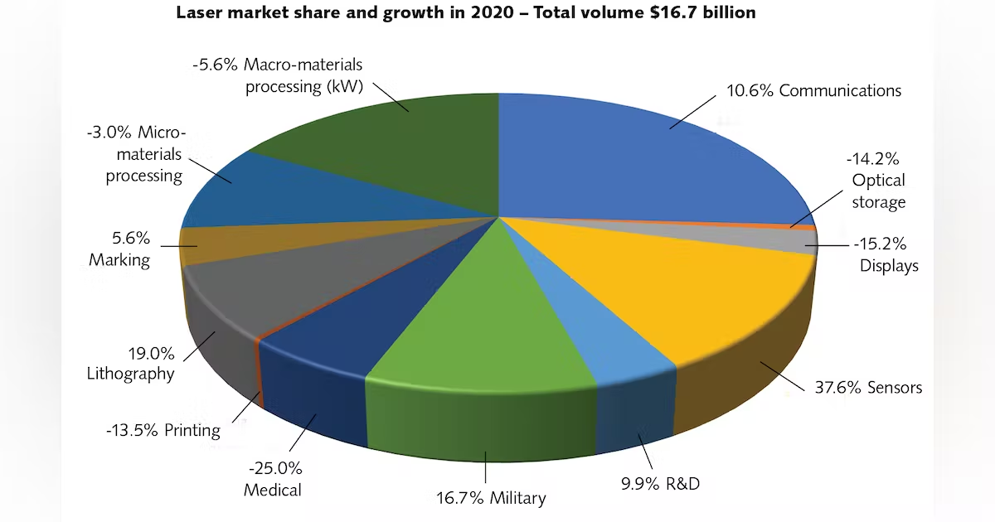
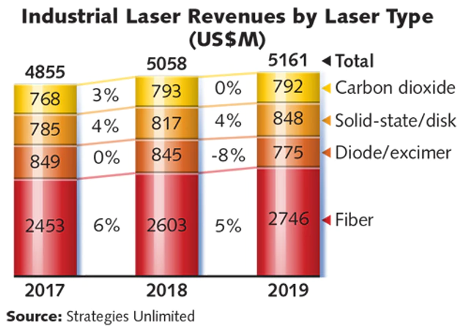
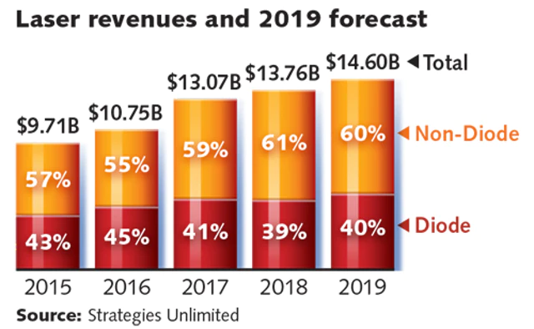
Laser Market and Applications

Slide 3
Ultraviolet
Visible
Infrared
dye lasers
excimer
lasers
semiconductor lasers
solid-state lasers
molecular gas lasers
atomic gas lasers
wavelength
100 nm
500 nm
1 μm
10 μm

Slide 4
Optical Transitions
2
2
discrete levels
OR
energy bands
1
1
emission
electronic transitions
VIS, UV
A
B
vibrational transitions
A
B
NIR, IR
rotational transitions
A
B
FIR
Proprietary Data
University of New Mexico

Slide 5
Typical laser efficiencies η :
Argon - ion < 0.1%
CO₂ laser < 20%
Excimer < 20%
GaAlAs (diode laser) < 40%
HeNe < 0.1%
Nd:YAG < 10%
Proprietary Data
University of New Mexico

Slide 6
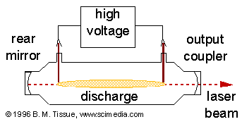
Gas Lasers (Examples: HeNe, Ar⁺, Excimer, CO₂,..)
The excitation mechanism in most gas lasers is via electric discharge

Slide 7
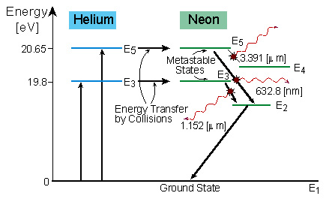
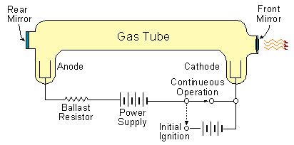
The first Gas Laser: He-Ne
Ali Javan, et al. (Bell Labs, 1962)
The second working LASER system to be demonstrated.
The first gas LASER to be produced.
The first LASER to produce a continuous output beam
The active laser medium is a gaseous mixture of He & Ne atoms, in a roughly 10:1 proportion
The gas is enclosed in a cylindrical quartz DISCHARGE tube

Slide 8
Comparison of Gas Lasers
Laser Type
Linear Power Density
W/m
Maximum Power
W
Power Efficiency
%
He-Ne
0.1
1
0.1
Argon
1-10
50
0.1
CO2
60-80
>10⁴
15-20

Slide 9
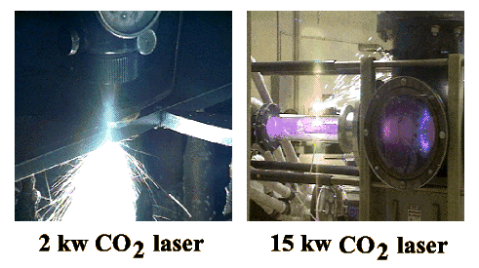
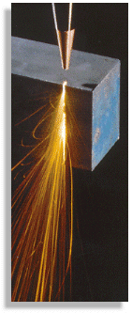
CO₂ Lasers (9-11 micron)
C. K. N. Patel, "Continuous-Wave Laser Action on Vibrational Rotational Transitions of CO2," Physics Review, Vol. 136 A, (Nov., 1964) P. 1187
Applications (pealing peanuts to star wars)
Industrial (cutting, welding, material processing)
Military (range finding, targeting, remote sensing, sensor blinding, destroying …)
Medical (cutting, skin resurfacing)
…..

Slide 10
Molecular Vibrations and Rotations
Transitions are between molecular vibrational-rotational levels.
O
C
O
Modes of vibrations:
Symmetric stretch
Asymmetric stretch
Bending mode

Slide 11
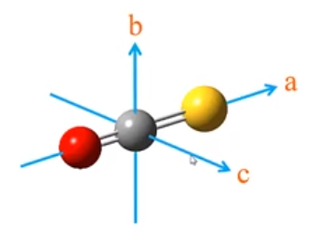
Simple Harmonic Oscillator (Quantum Mechanics):
Symmetric Stretch
Bending
Asymmetric Stretch
O
C
O
O
O
O
C
O
C
(200)
(001)
J=50
…..
J=18
….
J=1
Rotational states
10.6 μm
9.6 μm
(100)
(020)
(010)
(000)

Slide 12
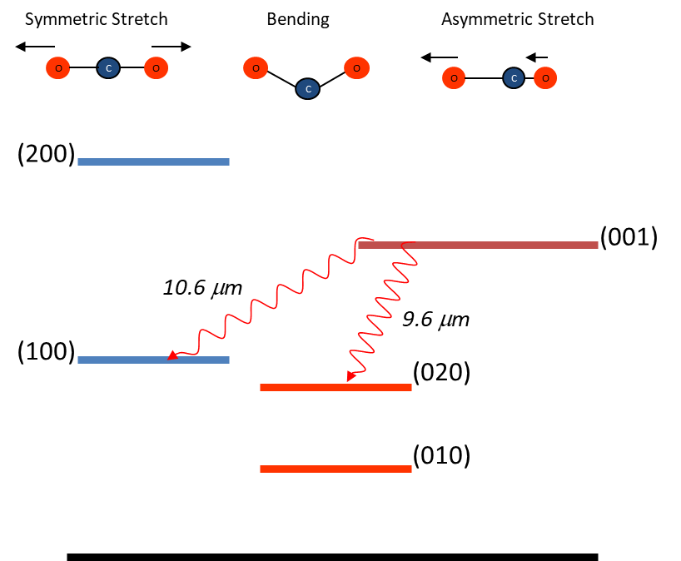







CO₂ Laser Transitions
λ(μm)
10.6
10.4
9.4
001 $→$100
001 $→$020
P- branch
J$→$J-1
R- branch
J $→$J+1
P- branch
J $→$J-1
R- branch
J $→$J+1
ν
P(50)
P(20)
R(17)
P(19)
Tuning:
diffraction grating
λ=9-11(μm)

Slide 13
Effect of Gas Mixtures: CO₂+N₂+He
He
N₂
(200)
(200)
(1)
Metastable
(100)
(100)
discharge excitation
(0)
Nitrogen helps populating the upper laser level in a discharge
Helium helps to depopulate the lower laser level by collisions
Typical Mixture CO₂/N₂/He (1/3/5),….
Other possible additions to the gas mixture: CO, H₂

Slide 14
11.3 Gas Discharge Phenomena
cathode
anode
e⁻
e⁺
+H.V.
Electrons emitted from cathode get accelerated by the electric field
The energetic electrons excite the vibrational modes of the gas molecule via inelastic collisions
Example:
L=1 meter and P=25 torr
Need V=25 kV for optimum operation

Slide 15
11.4 Specific Types of CO₂ Lasers
High Power CW Operation
DC-Discharge
Longitudinal discharge (High Voltage: 10-100 kV)
Pressure: 10-100 torr
Multistage discharge tubes can be used to produce kilowatts of output power
RF-Discharge
In practice waveguides are used.
High discharge stability, high pulsing frequency (up to 100 kHz)
Expensive RF generator and requires EMI shielding
0.2 W/cm in a waveguide laser

Slide 16
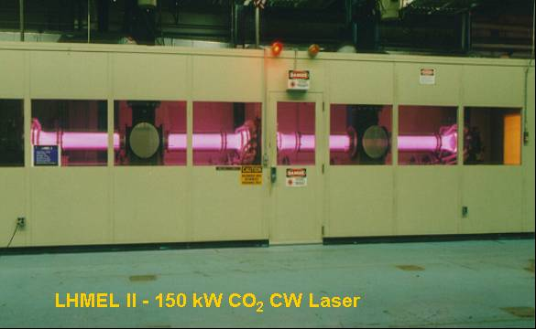
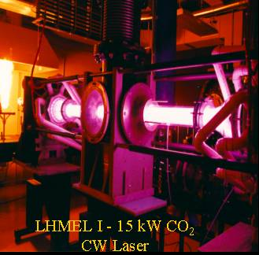
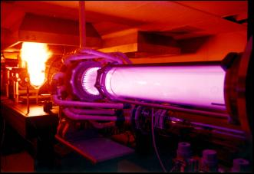
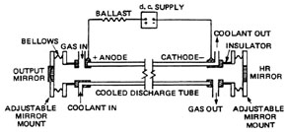
Laser Hardened Materials Evaluation Laboratory (LHMEL)
WP-AFB, Dayton, OHIO
Electric Discharge Coaxial Laser (EDCL)

Slide 17
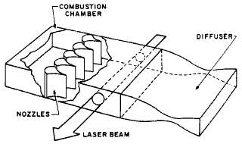
Gas-Dynamic Lasers
Basov & Oraevskii (1963)
Principle: Population inversion by rapid expansion (supersonic flow) of a super-heated gas
CO₂+N₂+H₂
_{T=1000-3000 K}
_{P=1-20 atm.}
v= 10⁵ cm/sec.
_{Inversion region}
cw powers up to 1 MW have been obtained from gas-dynamic CO₂ lasers !!

Slide 18
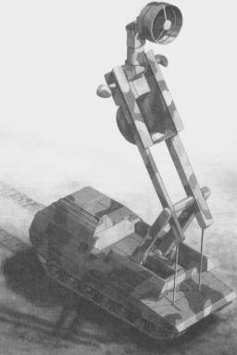
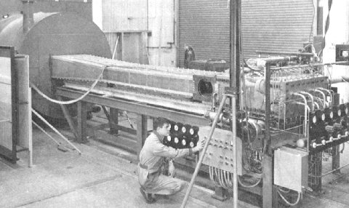
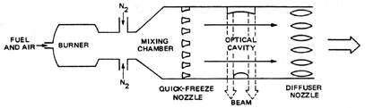
Gas-Dynamic Lasers
Large scale 135 Kilowatt gasdynamic laser at Avco Everett Research Lab.
C₂N₂ or CO
HELEX
High Energy Laser Experimental
Germany, 1970’s

Slide 19
Pulsed CO₂ Lasers
Most Common: Transversely Excited Atmospheric (TEA) CO₂ Lasers
Pulsed H..V
CO₂:N₂:He
Low pressure gain cell
(for single longitudinal operation)
Flowing or sealed systems
Pulsewidths from 50 ns to 300 ns
Repetition rates: 1Hz. to 1 kHz.
Pulse energy: 50 mJ to 10 J (amplified)

Slide 20
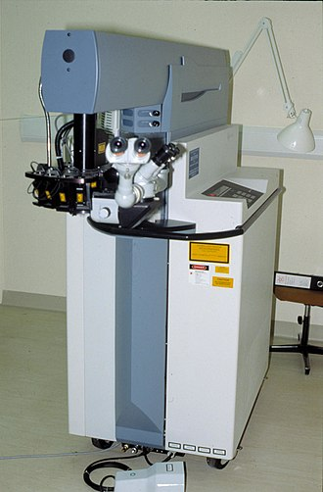
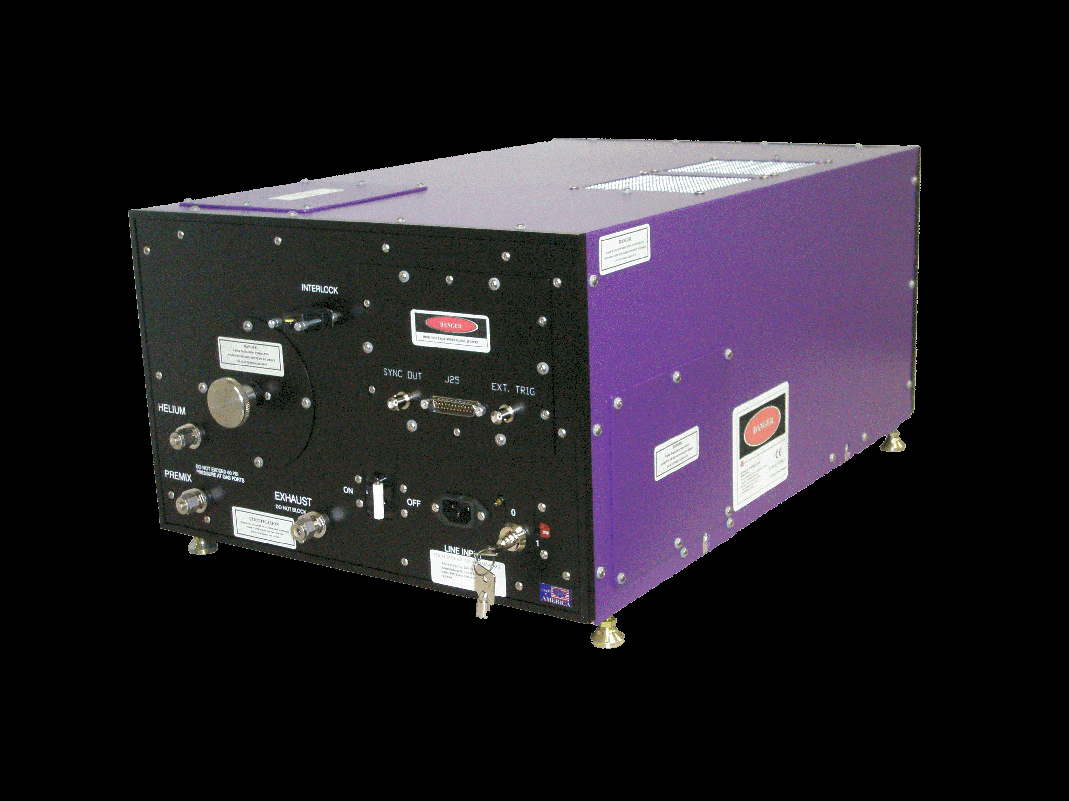
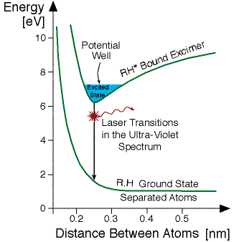
Excimer (Exciplex) Lasers
Nikolai Basov*, V. A. Danilychev and Yu. M. Popov, at the Lebedev Physical Institute
Applications: lithography, micromachining and eye surgery
Molecules exist only in the excited state
(Excimer=Excited-Dimer) or (Exciplex= Exciated-Complex)
XeCl* 308 nm
KrF* 248 nm
ArF* 193 nm
F_{2*} 156 nm
Pulsed, Typically 10-50 ns, 5-20 mJ
A
A
A
B*
B
B
excitation
emission
of a photon
*Nobel Prize, Physics (1964), Shared with Townes and Prokhorov
Proprietary Data
University of New Mexico

Slide 21
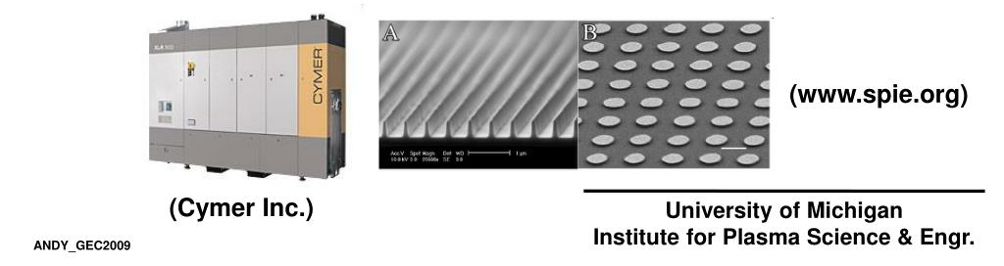
Excimer Lasers
Eye surgery
Lithography

Slide 22
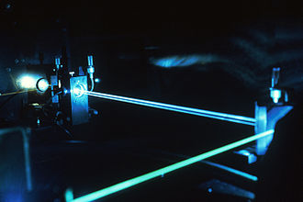
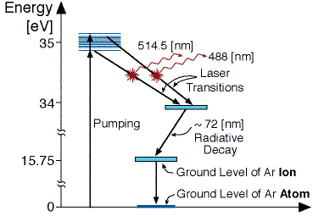
Argon Ion Laser
488 and 514 nm
Ar⁺

Slide 23
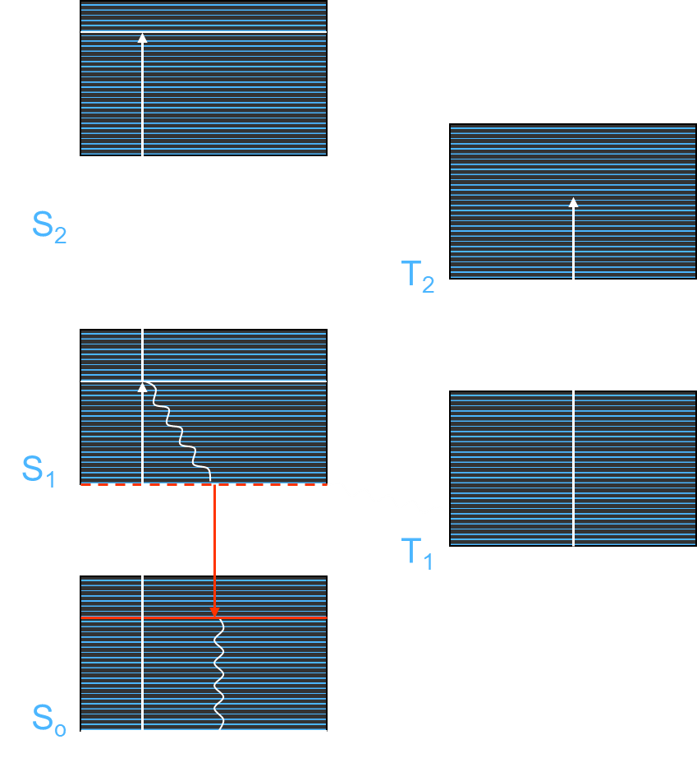
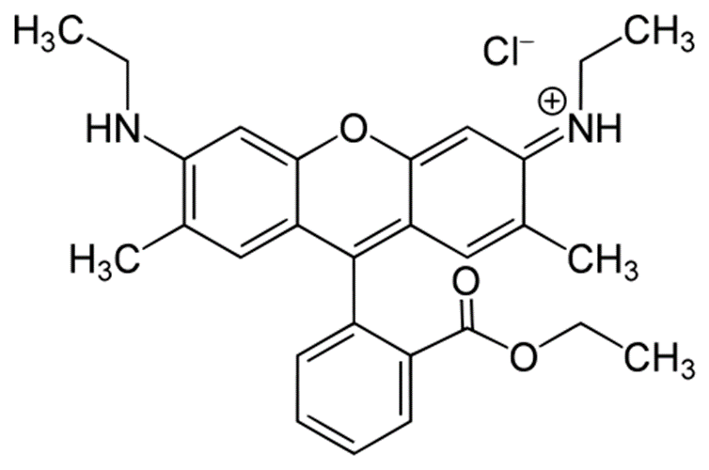
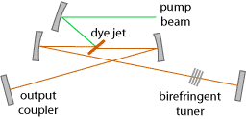
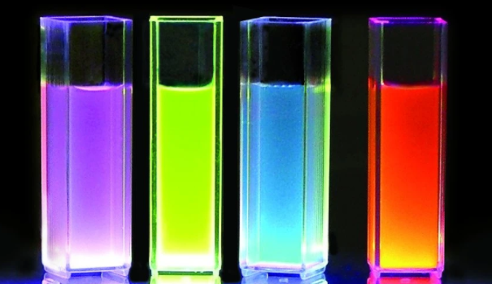
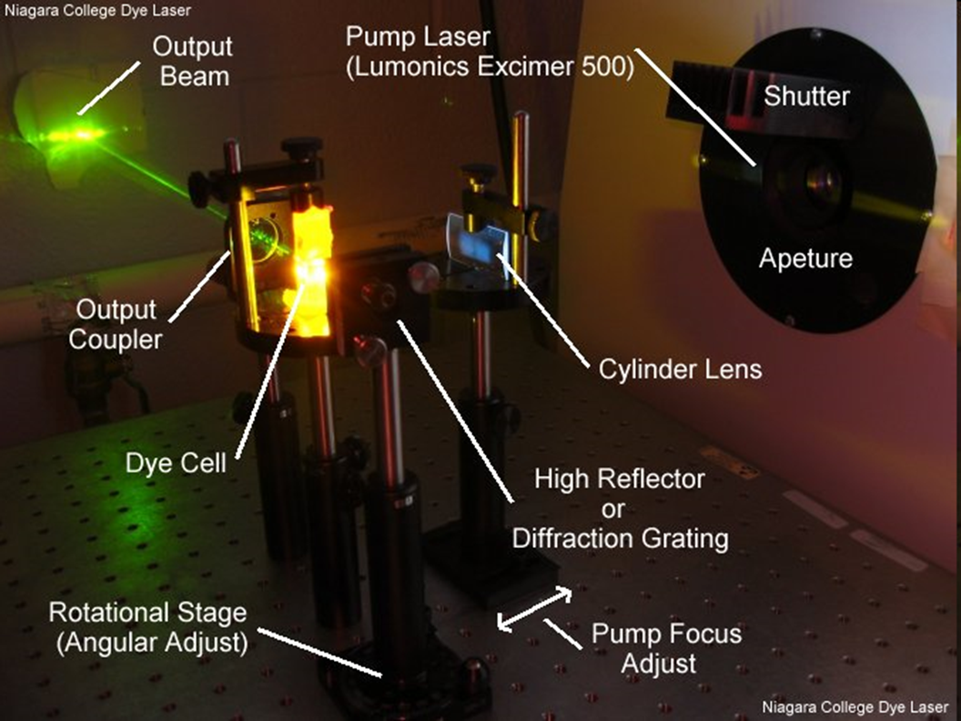
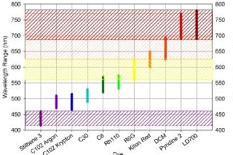
Organic Dye Lasers
Example: Rhodamine 6G

Slide 24
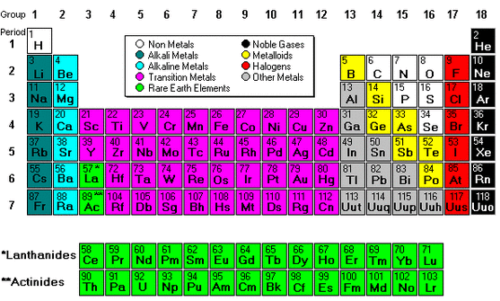
Solid-State Lasers
The lasing atoms (ions) are fixed in a solid (crystal, glass).
Solid-state lasers can operate in continuous (cw) or various pulsed modes.
The active ions are most commonly either a rare-earth or transition metal elements
host crystal
dopant
Examples:
(a) Nd³⁺ :YAG λ = 1.064 μm, 1.331 μm
(b) Nd³⁺ :glass λ = 1.062 μm (silicate glass), λ = 1.080 μm (fused silica)
Hm³⁺ :YAG, Tm³⁺ :YAG λ = 2.1 μm
Yb³⁺ : YAG, λ = 1.03-1.05 μm
Ti³⁺ :sapphire, λ = 0.7 - 1.1 μm
Fe²⁺ :ZnSe λ = 3.7 – 5.5 μm

Slide 25
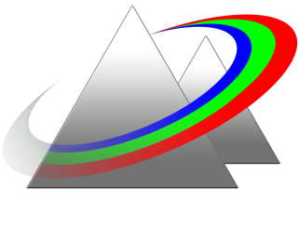
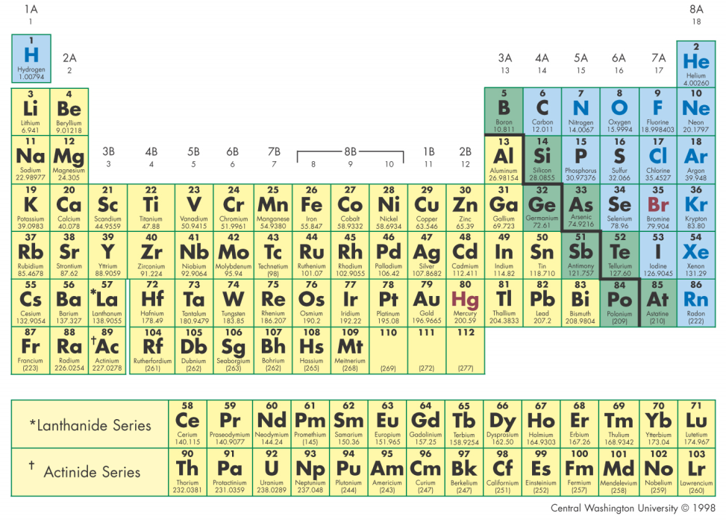
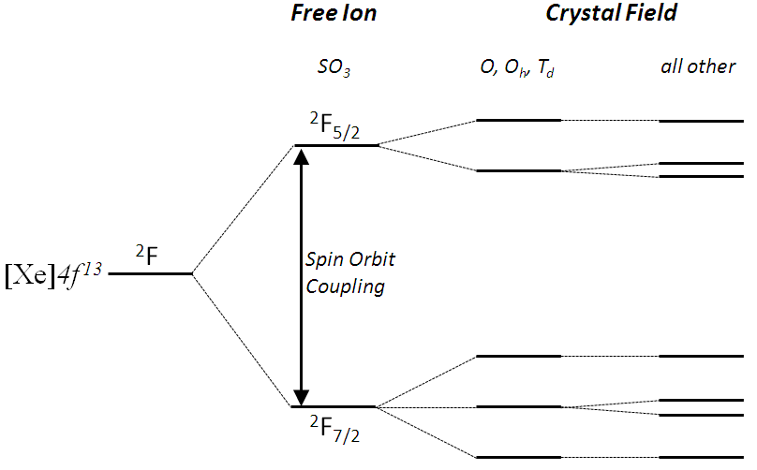



The 4f-4f transitions in Rare-Earths Ions:
Optical Science & Engineering
University of New Mexico
4f
6S
5S
Yb (Xe)4f¹³6s²
Yb³⁺ = (Xe)4f¹²
$$\begin{matrix}Letter & S & P & D & F & G & H & I \\ L & 0 & 1 & 2 & 3 & 4 & 5 & 6\end{matrix}$$
$${{}_{}^{2S+1}L}_{J}$$
Degeneracy: $g=2J+1$

Slide 26
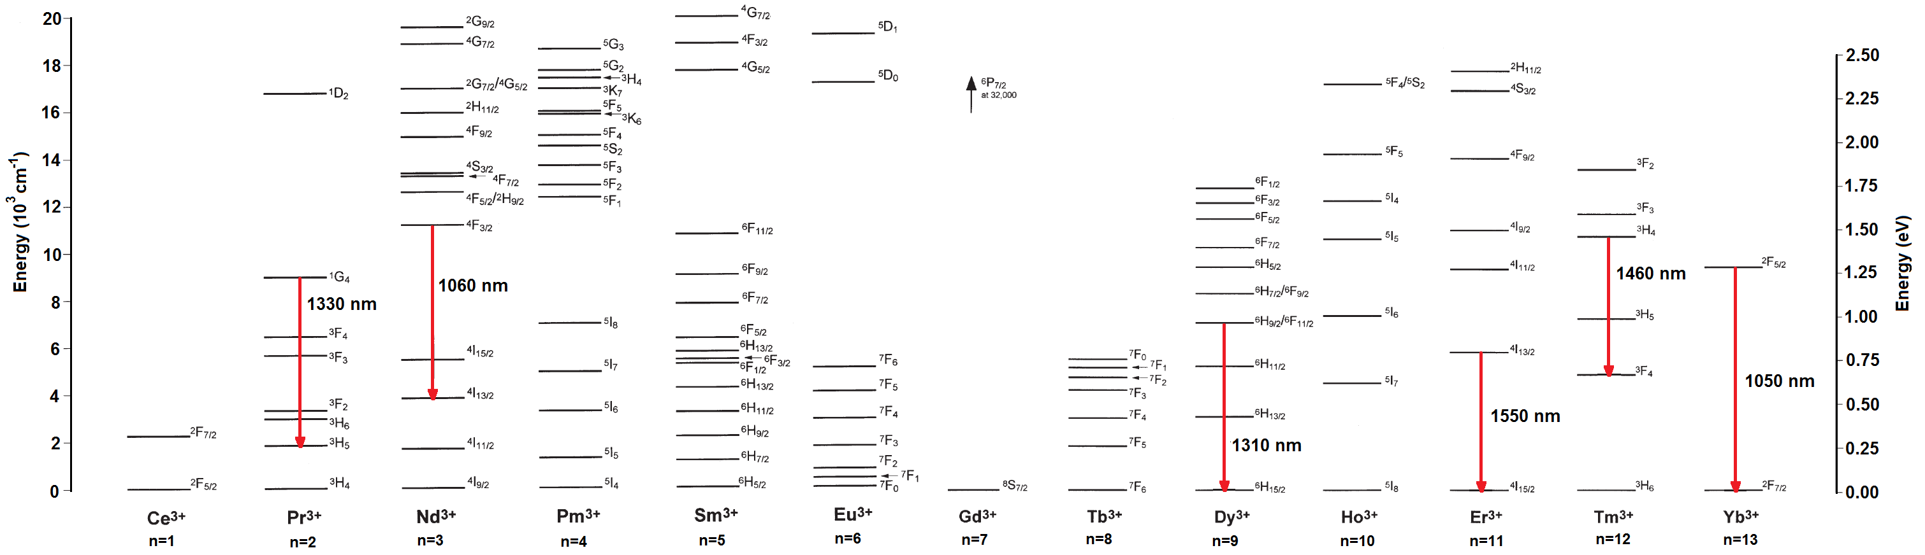
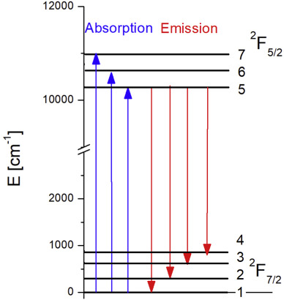
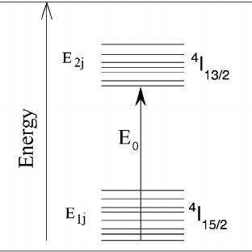

Rare-Earth Ion Doped Lasers
Lanthanides
$$≳kT$$
Quasi Four-Level Lasers

Slide 27
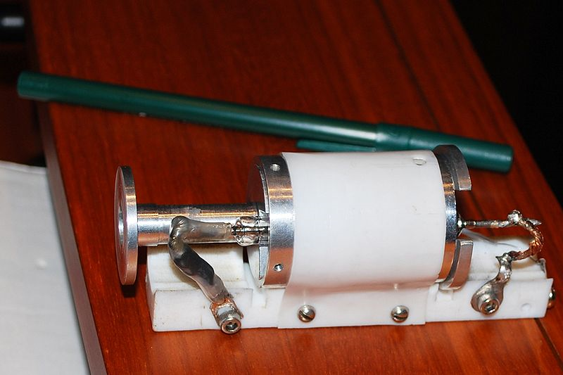
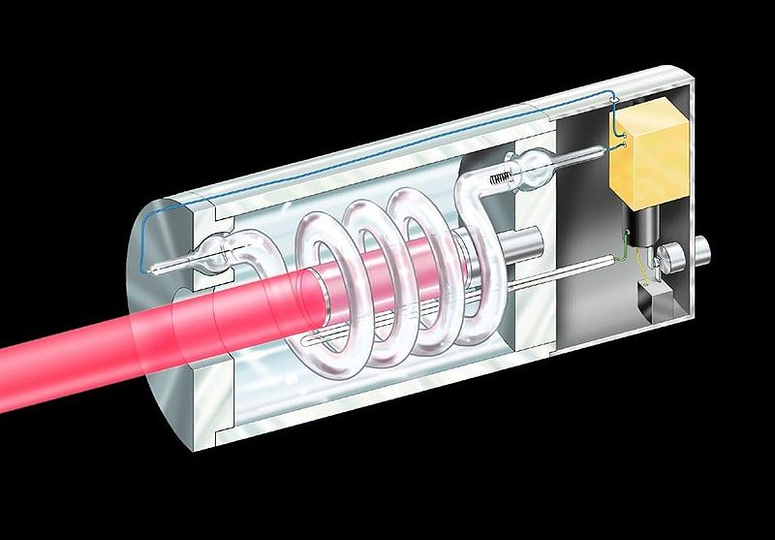
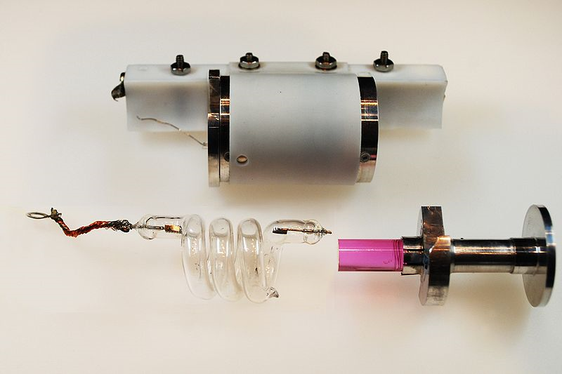
Maiman’s Ruby Laser

Slide 28
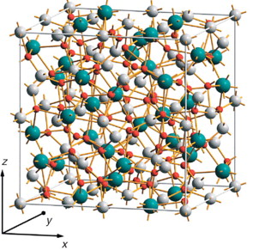
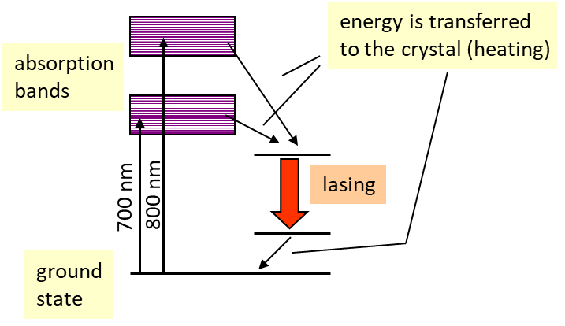


Example: Nd:YAG laser
YAG: Yttrium Aluminum Garnet (Y₃Al₅O₁₂)
Energy diagram of Nd³⁺:
Nd replaces Y
$$≫kT$$
Output (Nd:YAG, Nd:YLF, Nd: YVO₄ )
cw: ≤ 1000 W
pulsed: pulse energy ≤ 1 Joule
Q-switched – 5-20 ns pulse duration
modelocked – 10-100 ps pulse duration

Slide 29
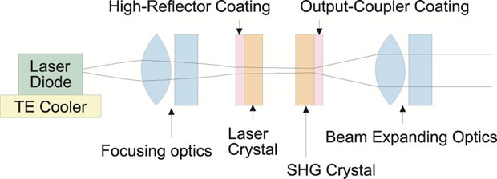
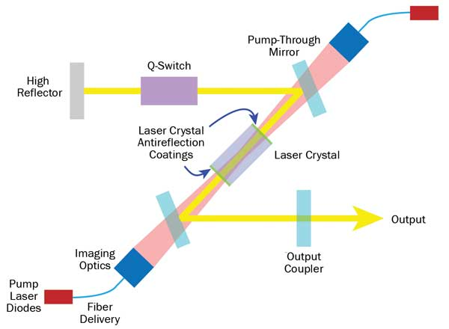
DPSS : Diode-Pumped Solid-State Laser
Similar to one used in our Optics Lab

Slide 30
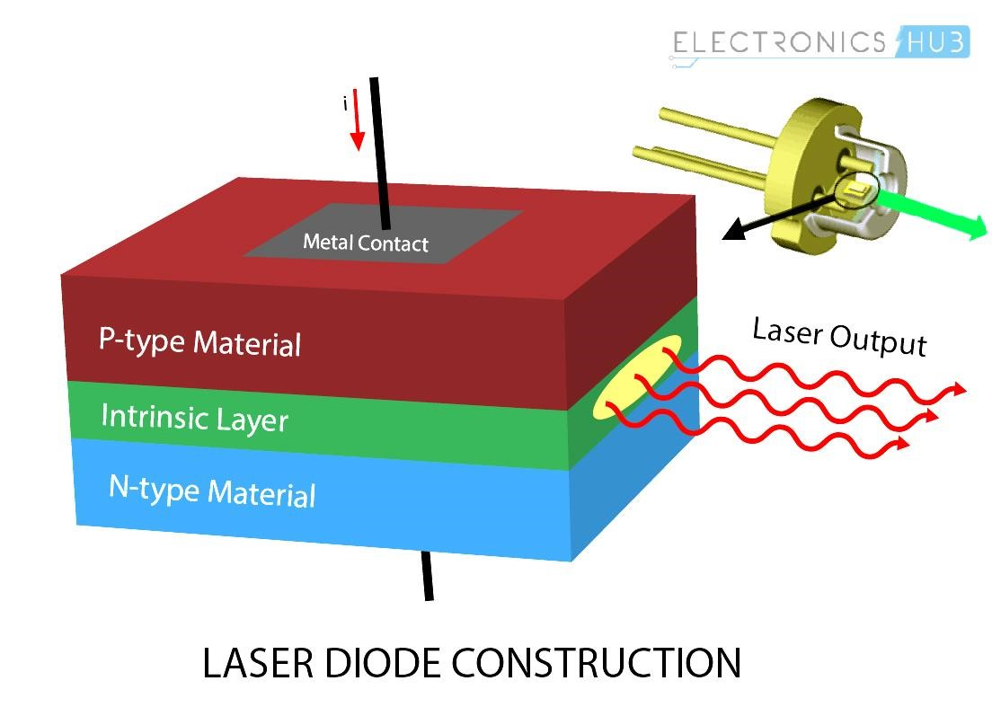
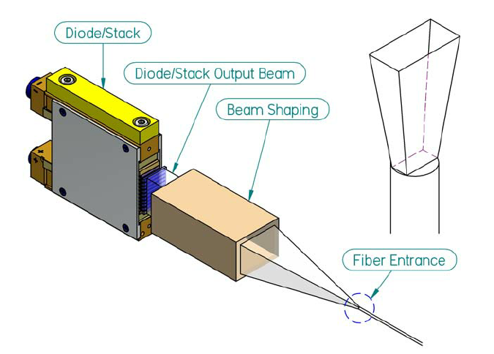
Diode Lasers for Pumping
Semiconductor lasers will be covered in more detail (next lecture)
Efficient (current injection)
High power
Designer Wavelength
Poor Beam Quality
Broadband (3-5 nm)
High Power (Diode Bar) Fiber Coupled

Slide 31
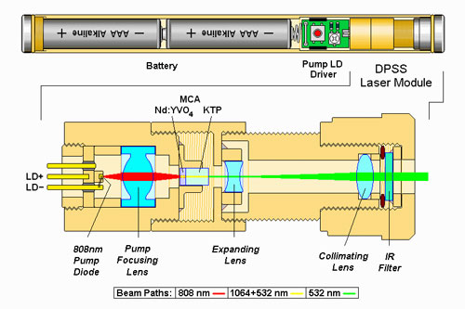
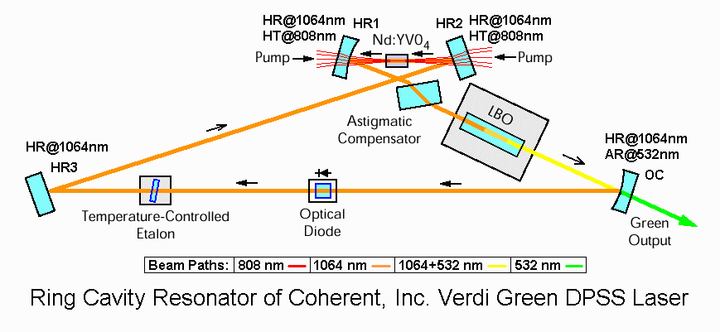
DPSS : Diode-Pumped Solid-State Laser
Example Nd:YVO₄ (Vanadate)
From laser pointers (5-10 mW) to 100W lasers
5-10mW
$20
5-10W
$10k-$40k

Slide 32
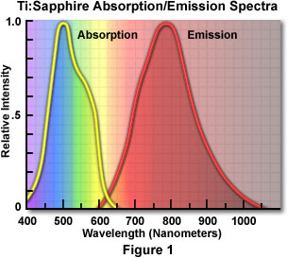
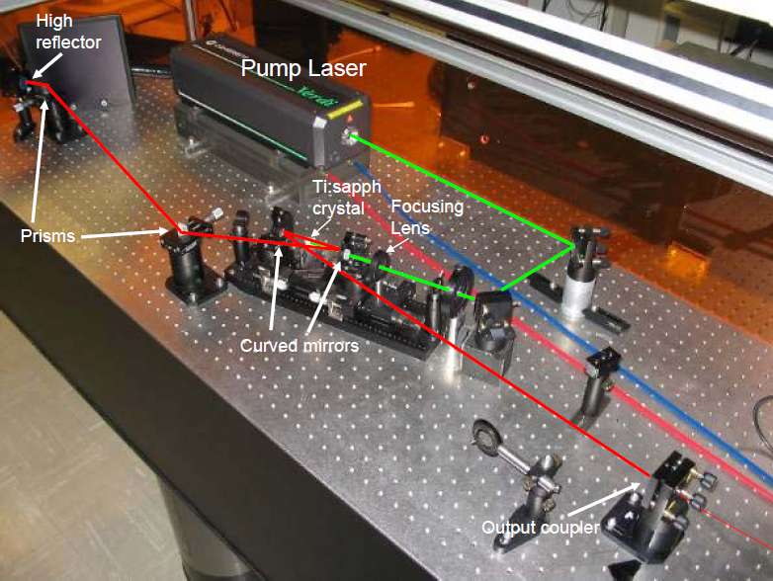

Titanium doped sapphire (Ti³⁺ :Al2O3) laser
The jewel of ultrafast lasers

Slide 33



Nobel Prizes
John L. Hall and Theodor W. Hänsch“
“for their contribution to the development of laser-based precision spectroscopy, including the optical frequency comb technique” (2005)
Gérard Mourou and Donna Strickland
“for their method of generating high-intensity, ultra-short optical pulses” 2018
Ahmed H. Zewail ”for his studies of the transition states of chemical reactions using femtosecond spectroscopy” 1999 (Chemistry)

Slide 34

High Power Scaling: Heat is such a nuisance!
Increase surface-to-volume ratio (fibers, disks)

Slide 35



Fiber Lasers

Slide 36


Fiber Lasers
Single-Mode Fiber
6 µm core / 125 µm cladding
High Beam Quality
Lower Power Pumping
Expensive Pumping
Multimode Fiber
50 µm core / 125 µm cladding
Higher Power Pumping
Inexpensive Pumping
Poor Beam Quality
Optical Fiber Modes
Graphics: courtesy of Colin Diehl & Jered Richter

Slide 37

Example: Erbium-Doped fiber Lasers
The wavelength of about 1550 nm is particularly interesting for applications in telecommunication.
EDFA: Erbium Doped Fiber Amplifier

Slide 38
Fiber-optic Communications
silica-glass fibers
1
attenuation coefficient (db/km)
Rayleigh
scattering
infrared
absorption
0.3
1.0
1.5
wavelength (μm)

Slide 39
Fiber transmission line
input
signal
signal
processing
transmitter
amplifier/
repeater
receiver
signal
processing
6000 km
InGaAsP
diode laser
transatlantic US - UK
80000 simultaneous voice channels
repeaters 100 km apart

Slide 40



High Power Fiber Lasers
Mainly: Yb Silica Fiber Lasers
Diode Pumped at 940-980 nm
Laser: 1020-1050 nm

Slide 41

High Power Fiber Lasers
Double-Clad Fiber
Laser light propagates in single-mode core
Pump light propagates in inner cladding

Slide 42


100 kW (current record)!

Slide 43


Slide 44




Slide 45

Thin Disk Lasers
Yb:YAG
Output-Coupler
>10 kW CW
D
d
Pump-Beam
Requires multipass pumping

Slide 46
Chemical Lasers
- population inversion is produced by a chemical reaction
A + BC AB + C*
- electrical power supply is not needed
- airborne lasers
- first chemical laser: 1964
chemical reaction:
- exothermic
- generation rate must be large
enough to overcome spontaneous
emission and collisional relaxation
Examples:
reaction active medium wavelength
F + D₂ → DF* + D DF 3.5 - 4.1 μm
Cl + HI → HCl* + I HCl 3.5 - 4.1 μm
H +Br₂ → HBr* + Br HBr 4.0 - 4.7 μm
F + H₂ → HF* + H HF 3.5 - 4.1 μm
molecules in an excited
vibrational state
I + O₂* → I* + O₂ I 1.31 μm
atoms in an excited
electronic state

Slide 47
The chemical oxygen-iodine laser (COIL): MW CW Power !!
Singlet oxygen (dioxidene) has a >40 min lifetime.
chemical reaction:
O₂(¹ Δ) + I ↔ O₂(³Σ ) + I*
O₂(¹ Δ)
O₂(³ Δ)
energy transfer
O → I
I
I*
steps:
1. generation of singlet oxygen Cl₂ + H₂O₂ +2NaOH → O₂(¹ Δ) + 2H₂O + 2NaCl
2. production of excited iodine O₂(¹ Δ) + I ↔ O₂(³Σ ) + I*
3. lasing of excited iodine

Slide 48

schematic diagram of a chemical iodine laser
parameters
iodine
mixer
supersonic
nozzle
MW ouput power
wavelength 1.315 micron
pulsed and cw
expanding
gas (cooling)
singlet oxygen
laser
output
atmospheric absorption
1 km propagation in atmosphere
1.0
0.8
0.6
absorption
absorption
0.4
0.2
0.0
1
2
3
4
5
wavelength (μm)
μ
wavelength (
m)

Slide 49





Free Electron Laser (FEL)
wiggler period
$$λ_{r}≈\frac{λ_{w}}{2γ^{2}}$$
$$γ=\frac{1+K^{2}/2}{\sqrt{1−β^{2}}}>{10}^{4}$$
$$K∝|B|$$
wiggler strength
(often <1)

Slide 50



Semiconductor Lasers

Slide 51

Laser Market and Applications

Slide 52



What is a semiconductor?

Slide 53

Direct-Gap vs. Indirect-Gap
E(energy)
k (momentum)

Slide 54


Slide 55

Optical Interactions in a Direct-Gap Semiconductor

Slide 56
A Brief Introduction to Semiconductors
Energy Bands
E
1 0
Equilibrium
Fermi-Dirac Statistics
http://britneyspears.ac/lasers.htm !!!???

Slide 57
Nonequilibrium Electron-Hole Injection
10⁴ cm⁻¹
Example
GaAs
E_{g}=1.4 eV
(λ_{g}=850 nm)
Gain
Gain
Absorption or
Absorption or
0
0
hω
E
E
g
g

Slide 58
Section 12.1 p.2
p-n junctions
Doping with Impurities
n-type
p-type
E_{f}
E_{g}
E_{g}
E_{f}
Examples: GaAs doped with Br
Si doped with P
Examples: GaAs doped with Zn
Si doped with Al

Slide 59
Semiconductor junction lasers
Forward-Biased p-n Junction (LED)
n⁺-GaAs
p⁺-GaAs
+ V
d
Inversion (Gain) Layer
Current Density Threshold
Recombination time

Slide 60
Section 12.2 p.2
Edge-Emitting Homojunction Laser Diodes
L_{g}≅100 μm
Waveguide Modes
Homojunction Lasers have very high current threshold mainly because.
Electrons and holes are free to diffuse and therefore dilute the gain (no carrier confinement)
Optical mode has poor overlap with gain (no optical confinement or guiding)

Slide 61
12.3 Heterojunction Lasers Diodes
A fortunate coincidence:
n when E_{g}
electrons
^{n+}
^{AlGaAs}
GaAs
^{p+}
^{AlGaAs}
Energy
Carrier confinement
holes
holes
100 nm
Index of Refraction
Mode confinement

Slide 62


Section 12.3 p.2
Edge-Emitting Heterojunction Laser Diodes
Edge-Emitting Buried Heterojunction Laser Diodes

Slide 64
12.4 Quantum Well Lasers
Multiple Quantum Well (MQW) Lasers
^{n+}
^{AlGaAs}
10 nm
^{p+}
^{AlGaAs}
mode confinement
Epitaxial Growth

Slide 65

Section 12.4 p.2
High Power Diode Bars
P>100 W (cw)
Diode-pumping solid-state lasers (DPSS)
Material Processing
…

Slide 66
Section 12.4 p.3
Vertical Cavity Surface Emitting Lasers (VCSEL)
Good mode quality couples to fiber efficiently for telecom applications
Single mode operation
2-D structures cam be made
Low power

Slide 67



Optically-Pumped Semiconductor Lasers (OPSL)

Slide 68
Section 12.4 p.4
Laser Diodes Cover the Spectrum
Compound | Spectral Region | Notes
Al_{x}Ga_{1-x}N GaN In_{x}Ga_{1-x}N | uv uv (350 nm) blue (480-400 nm) | data storage, display
Ga_{x}I_{1-x}P (x=0.5) Ga_{x}Al_{1-x}As (x=0-0.45) | 670 nm 620-895 nm | display
GaAs In_{x}Ga_{1-x}As (x=0.2) | 904 nm 980 nm | diode pumping solid-state and fiber lasers.
In_{x}Ga_{1-x}As_{y}P_{1-y} (x=0.73, y=0.58) (x=0.58, y=0.9) | 1100-1650 1310 nm 1550 nm | Telecom
PbSSe | 4200-8000 nm | cryogenic
PbSnTe | 6300-29,000 nm | cryogenic

Slide 69

12.5 Recent Advances: Quantum Cascade Lasers

Slide 70

Section 12.5 p.2

Slide 71

THE END !

