Slide 1
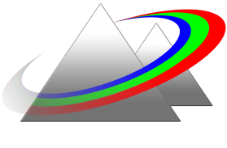
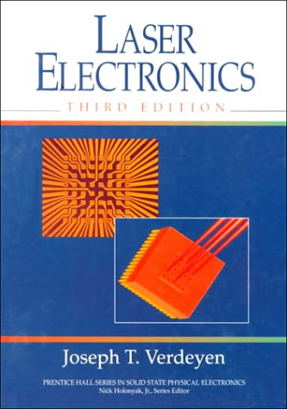
Laser Physics I (PHYS/ECE/OSEP 464)
Fall 2022
Instructor: Mansoor Sheik-Bahae
OPTICAL SCINCE & ENGINEERING
University of New Mexico
Office: PAIS 2220
Phone: 226-3693
E-mail: msb@unm.edu
https://msbahae.unm.edu/Courses/464%20Laser%20Physics%20I/index.html
To see me in my office, please make an appointment (email).
Class meeting times: Mondays, Wednesdays 16:00-17:15
Textbook: Laser Electronics By Joseph T. Verdeyen
Reference Textbooks:
Optical Electronics in Modern Communications by Amnon Yariv,
Lasers by A. E. Siegman, Laser Fundamentals by William Silfvast
Pre-requisites: E&M, Modern Physics, Knowledge of Differential Equations, Linear & Complex Algebra.
Teaching Assistant: Duncan McGraw; TAs Office Hours: Email for Appointment
Homework problem sets will be assigned on a regular basis throughout the semester, most likely one set per week.
Tests: There will be two exams: One Midterm and the Final Exam.
Tentative Test Date: Midterm: Tentatively Wed. Oct. 26 (4-6:00pm), PAIS 1140, Covers Chapters 1-8
Grading: The final grade is weighted as follows: Midterm: 35%, Final: 50% , Homework: 15%

Slide 2
Course Syllabus
1- Introduction (historical overview) [1 lecture]
2- Review of E&M theory (Chapter 1) [2 lectures]
3-Ray tracing (ABCD matrix method) (Chapter 2) [3 lectures]
4-Gaussian Beams (Chapter 3) [4 lectures]
5-Optical Cavities (Chapter 5 & 6) [2 lectures]
6-Gain Medium (field-atom interaction) (Chapter 7) [5 lectures]
7- Laser Oscillation (Chapter 8) [4 lectures]
8- General Laser Characteristics (Chapter 9) [6 lectures]
9- Various Laser Systems (Parts of Chapters 10 & 11) [3 lectures]

Slide 3
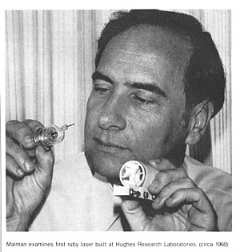
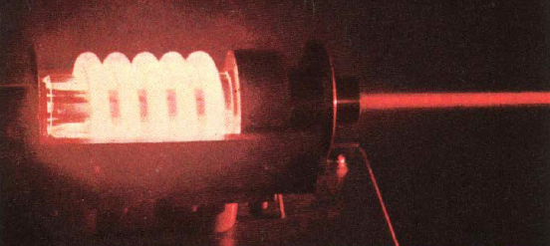
Introduction (historical overview)
Laser Turns 62
LASER:
Light Amplification by Stimulated Emission of Radiation
May 17, 1960
Ted Maiman

Slide 4
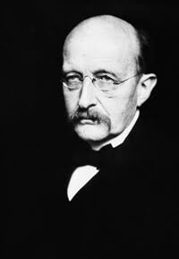
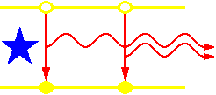
A Brief History of Laser
Quantum mechanics is born: Planck (1900), Bohr (1913)
Einstein postulated the principle of the “stimulated emission” (1917)
Also See:
https://www.photonics.com/Articles/A_History_of_the_Laser_1960_-_2019/a42279

Slide 5
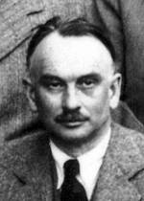
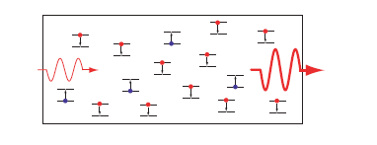

Slide 6
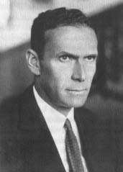
(1928) Observation of negative absorption or stimulated emission near to resonant wavelengths, Rudolf Walther Ladenburg
E₂
E₁
Stimulated Emission
(negative absorption)

Slide 7
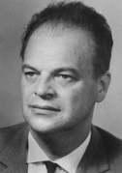
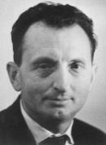
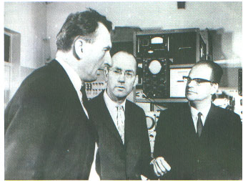
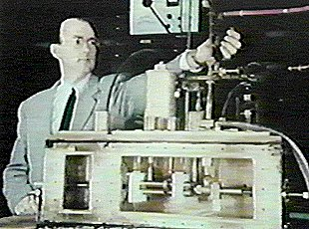
A Brief History of Laser
MASER is invented (Townes, Basov and Prokhorov) 1954
Some critics (then) called it(the MASER) : Means of Acquiring Support for Expensive Research !

Slide 8
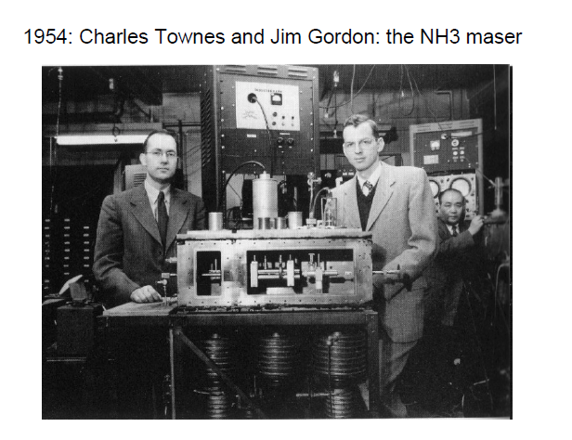

Slide 9
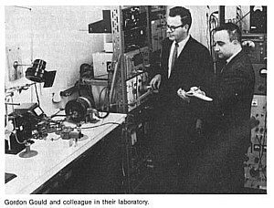
Laser operation is predicted by Shawlow and Townes (1957)

Slide 10
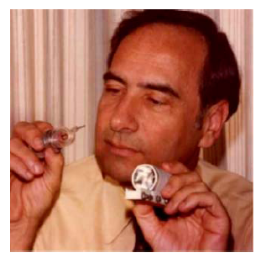
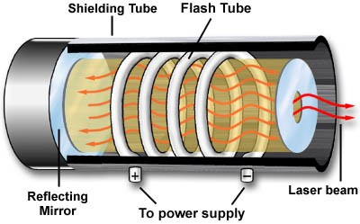
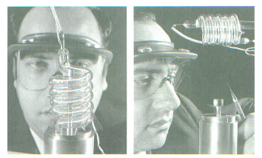
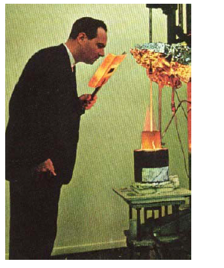
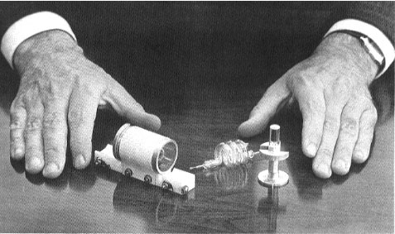
The Laser Happens!
May 17, 1960
Theodore H. Maiman
" Stimulated optical radiation in ruby " Nature Vol 187 p. 493 ( Aug. 6 , 1960 )
…..just another maser !!??

Slide 11
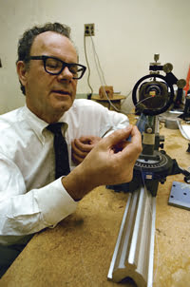
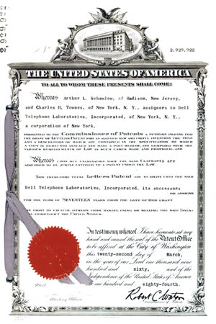
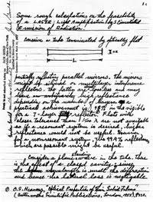
The Gordon Gold and the 20+ years patent war!
1979: Gould receives a patent covering a broad range of laser applications.

Slide 13
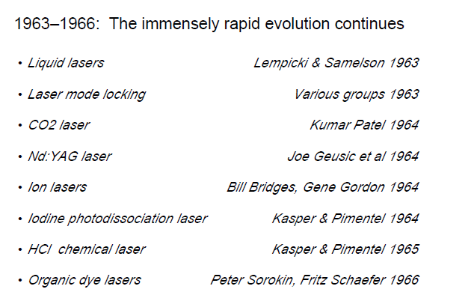

Slide 14
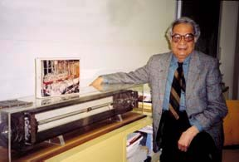
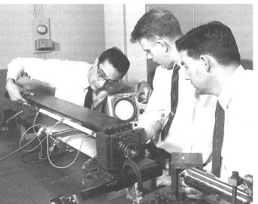
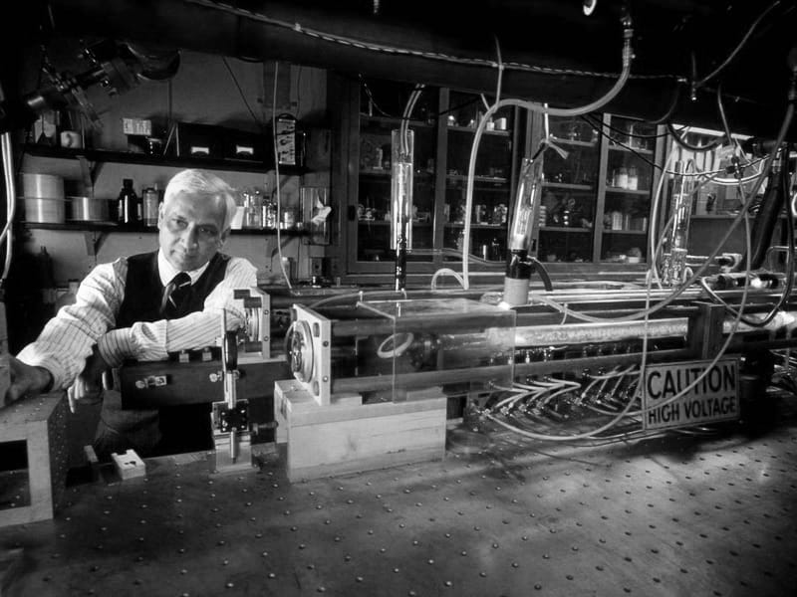
AT&T Bell Labs: The Golden Age!
He-Ne Laser (1960)
Ali Javan
CO₂ Laser (1964)
Kumar Patel

Slide 15
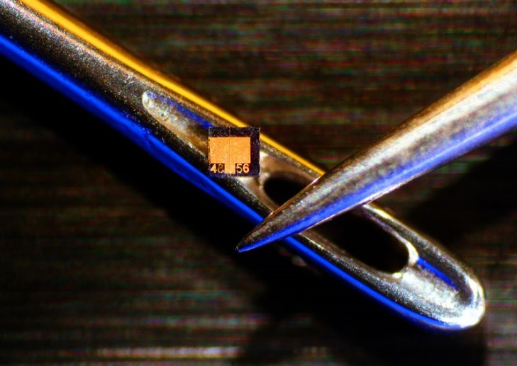
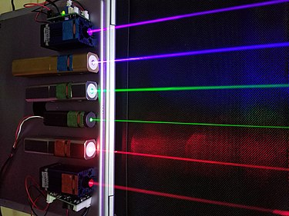
Semiconductor Lasers
1962: Groups at GE, IBM, and MIT’s Lincoln Laboratory simultaneously develop a gallium-arsenide laser.
1962: Laser Diode by two US groups led by Robert N. Hall at the General Electric research center and by Marshall Nathan at the IBM T.J. Watson Research Center.

Slide 16
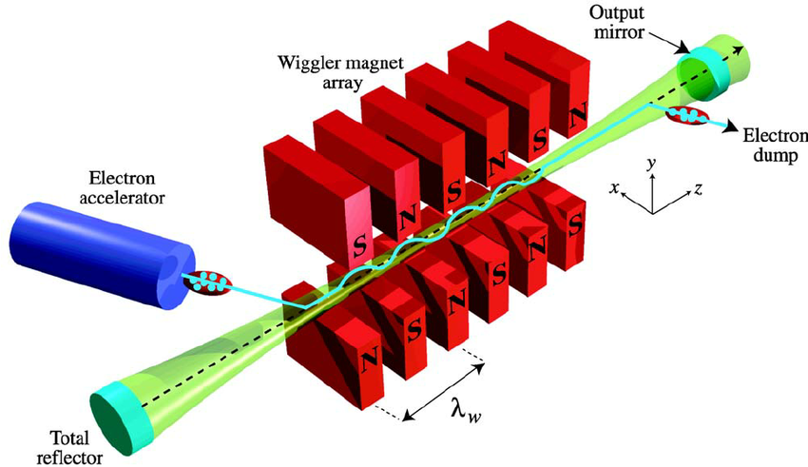
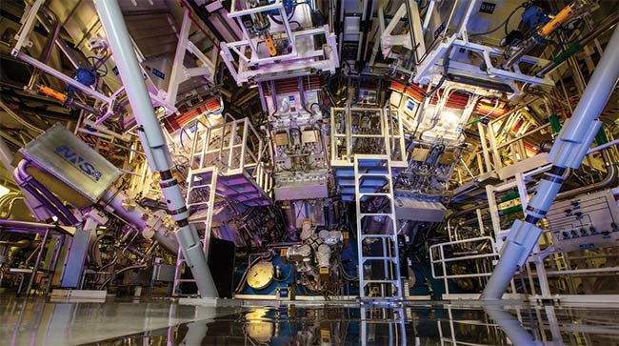
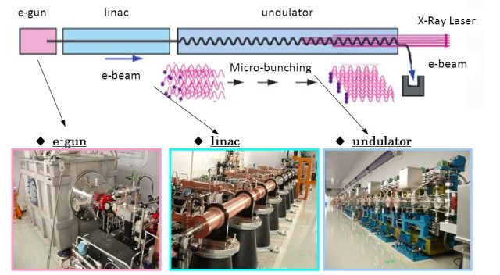
Big Science & User Facility Lasers :
Free Electron Laser (FEL)
National Ignition Facility (LLNL)
High-Energy (MJ) Pulsed Solid-State Laser Chain

Slide 18
Laser was also once called:
“solution looking for a problem!!”
http://www.imdb.com/video/wab/vi1636107033/
By: Lawrence Sutherland

Slide 22
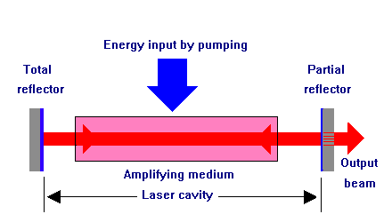
Main Components of a Laser
Power Supply or Pump Source
Examples are arc-lamp, another laser, electric discharge, chemical reaction, electrical current.
Gain (Amplifying) Medium
Can be solid, gas or liquid
Laser Cavity (Resonator)
Simplest: two mirrors

Slide 23
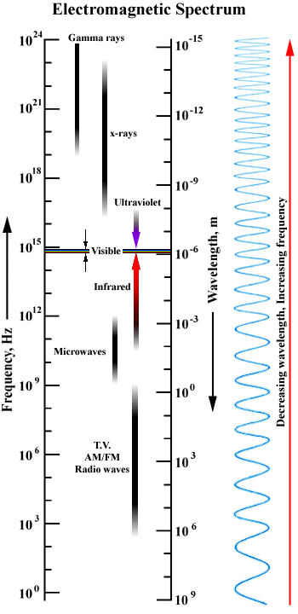
What is a laser?
What is light?!
Electromagnetic radiation:
+E₀
-E₀
Propagation is governed by Maxwell’s equations

Slide 24
Properties of Laser Radiation
High degree of temporal coherence (almost single wavelength)
High degree of spatial coherence (highly directional, low divergence)
Efficient (e.g., wall plug efficiencies of 50% in semiconductor lasers)
Very very short pulses (<10 fs) have been generated (also <100 attosec in XUV)
High average (e.g. > 100 kW) and peak powers (e.g. > 10 TW) can be achieved

Slide 25
Temporal and Spatial Coherence
Temporal Coherence: The phase ϕ(t) can vary randomly with time.
The coherence time ( ) is defined as the mean interval between such random variations.
τ_{c}
τ_{c}
Spatial Coherence: The phase ϕ(r) can vary randomly with transverse distance of an extended source
Spatially coherent
r
z
Spatially incoherent

Slide 26
Light Intensity (I) and Power (P)
Since optical frequencies are very high (>10¹⁴ Hz), the detectors measure a time average of the flux density contained in the electromagnetic field. This is called the light intensity and has units of power per unit area:
beam area
n= refractive index
c= speed of light in vacuum (3x10¹⁰ cm/sec)
ε₀= permittivity of free space (8.85x10⁻¹² F/m)
Another commonly used attribute of light:
Brightness= Power/(Solid Angle x Area)

Slide 27
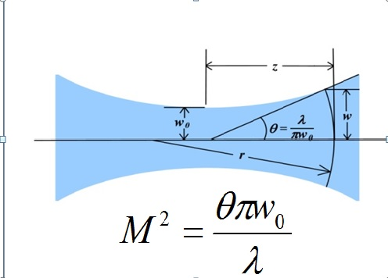
M ² is also often used to describe the beam quality (coherence) of a laser beam:
M²=1 (good)
M²>2 (poor)

Slide 28
The Photon
In addition to the wave nature, light (electromagnetic waves) also can be viewed as stream of quantum particles with energy of each particle is given:
E=hν=hc/λ
where h=6.63x10⁻³⁴ J-sec is the Plank’s constant.
E=hν=hc/λ
Photon density in an optical beam (number of photons per unit volume):
useful formulas: λ(μm)≈1.24/E(eV)
λ(μm)=10000/E(cm⁻¹)

