Slide 6
Small Depletion Approx.

Slide 10
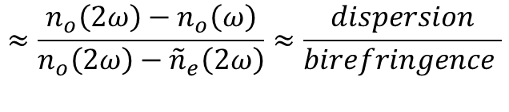
$$≈\frac{n_{o}\left(2ω\right)−n_{o}\left(ω\right)}{n_{o}\left(2ω\right)−{\tilde{n}}_{e}\left(2ω\right)}≈\frac{dispersion}{birefringence }$$

Slide 11
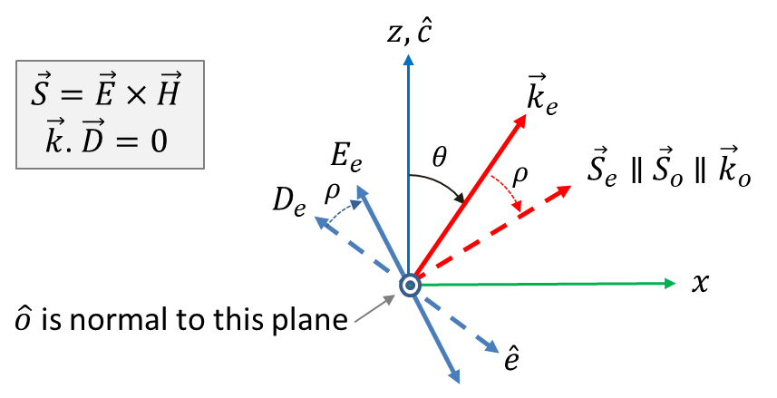
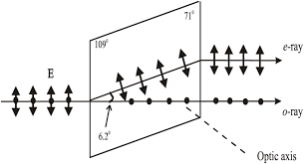
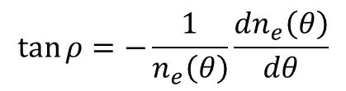
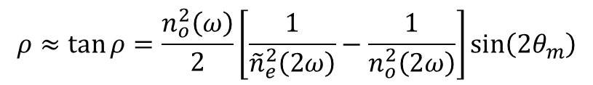
Problem 3. Poynting Vector Walk-off:
We know, from linear optics, that the e- and o-rays in a birefringent crystal walk-off from each other (i.e. double-refraction) resulting from the fact that ke and ko are not parallel. Known as Poynting vector walk-off, this is essentially the angle (ρ) between E and D vectors for the e-ray where D=ϵ:E.
$$\tan{ρ}=−\frac{1}{n_{e}\left(θ\right)}\frac{dn_{e}\left(θ\right)}{dθ}$$
$$ρ≈\tan{ρ=\frac{n_{o}^{2}\left(ω\right)}{2}\left[\frac{1}{{\tilde{n}}_{e}^{2}\left(2ω\right)}−\frac{1}{n_{o}^{2}\left(2ω\right)}\right]\sin\left(2θ_{m}\right)}$$

Slide 13
E.J. Lim, M.M. Fejer, R.L. Byer, Second harmonic generation of green light in a periodically-poled planar lithium niobate waveguide, Electron. Lett. 25 (1989) 174–175.
Byer, R.L., 1997. J. Nonlinear Opt. Phys. Mater. 6, 549.
Fejer, M.M., Magel, G.A., Jundt, D.H., Byer, R.L., 1992. IEEE J. Quantum Electron.8,2631.
Khanarian, G., Norwood, R.A., Haas, D., Feuer, B., Karim, D., 1990. Appl. Phys. Lett. 57, 977.
Yamada, M., Nada, N., Saitoh, M., Watanabe, K., 1993. Appl. Phys. Lett. 62, 435.

Slide 14
Manley-Rowe (1959)
We see that the sign of dI1/dz is the same as that of dI2/dz but is opposite tothat of dI3/dz.
We also see that the direction of energy flow depends on the relative phases of the three interacting fields

Slide 15

SFG and Up-Conversion
assume that the amplitude A2 of the field at
frequency ω2 is unaffected by the interaction,
$$Δk=0$$
C=0; B=A₁(0)

Slide 16
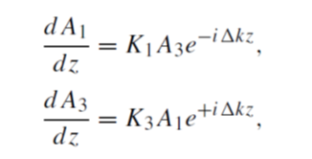

SFG and Up-Conversion
(1)
(2)
assume that the amplitude A2 of the field at
frequency ω2 is unaffected by the interaction,
$$Δk≠0$$
Sub. Into (2),…..

Slide 18
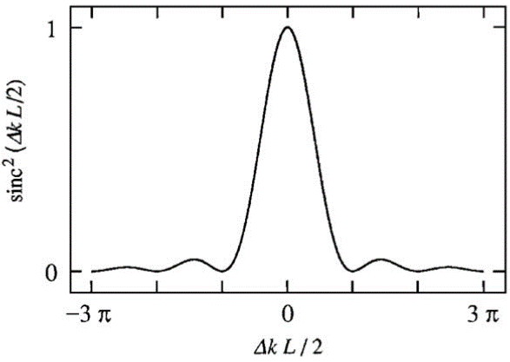
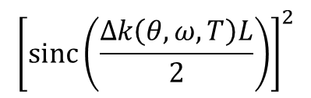

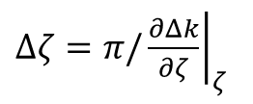
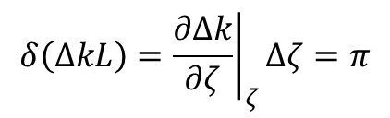
Acceptance Angle and BW
$${\left[\operatorname{sinc}\left(\frac{Δk\left(θ, ω,T\right)L}{2}\right)\right]}^{2}$$
$$δ\left(ΔkL\right)={\left.\frac{∂Δk}{∂ζ}\right|}_{ζ}Δζ=π$$
$ζ$= $\left(θ, ω,T\right)$
$Δζ=π/{\left.\frac{∂Δk}{∂ζ}\right|}_{ζ}$

Slide 19
SHG- Exact Solution
An example of the solution for one particular
choice of initial conditions is shown
JaJacobi elliptic functions
More general when $Δk≠0$ : elliptic integrals

Slide 20

When E₂=0 at z=0, then $Γ=0, and$

Slide 21
DFG
we can treat A3 as being essentially constant)

Slide 22
DFG

Slide 23
OPO

Slide 24
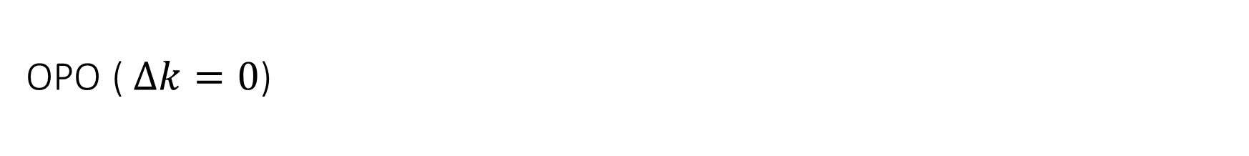
OPO ( $Δk=0$)
DRO
SRO

Slide 25
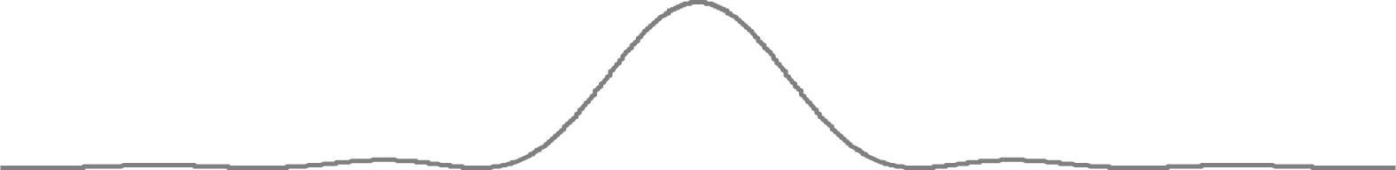


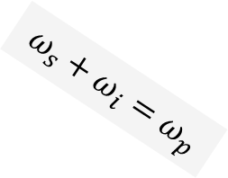

Singly Resonant OPO (SRO)
$$ω_{s}+ω_{i}=ω_{p}$$
$$ω_{i}=m×ω_{qi}$$
$$Δk=0$$
$$ω_{s}$$

Slide 26
Singly Resonant OPO (SRO)
$$ω_{s}+ω_{i}=ω_{p}$$
$$ω_{i}=m×ω_{qi}$$
$$Δk=0$$
$$ω_{s}$$

Slide 27



Doubly Resonant OPO (DRO)
$$ω_{s}+ω_{i}=ω_{p}$$
$$ω_{i}=m×ω_{m}$$
$$Δk=0$$
$$ω_{s}=q×ω_{q}$$

Slide 28
Doubly Resonant OPO (DRO)
$$ω_{s}+ω_{i}=ω_{p}$$
$$ω_{i}=m×ω_{m}$$
$$Δk=0$$
$$ω_{s}=q×ω_{q}$$

Slide 29
Oscillating Modes in OPO
SRO
DRO

Slide 30
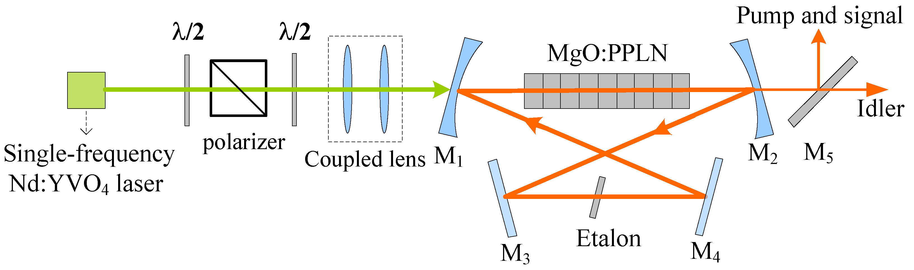
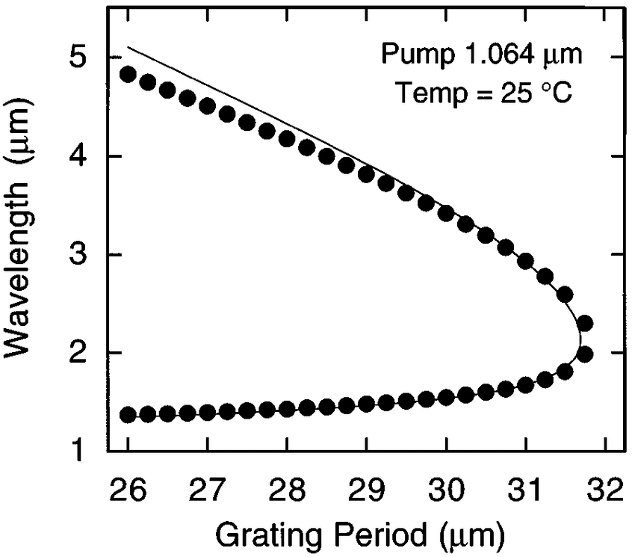

Slide 31
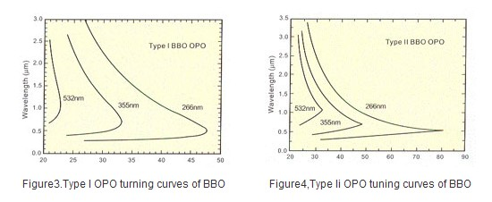
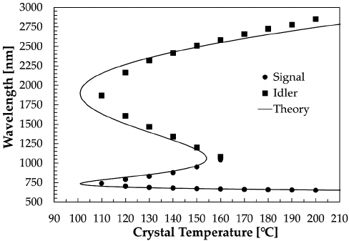

Slide 32

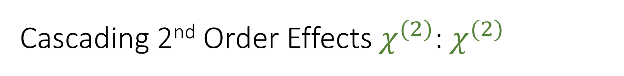

Cascading 2nd Order Effects $χ^{(2)}$: $χ^{(2)}$
$$χ^{(2)}$$
$$χ^{(2)}$$

Slide 33
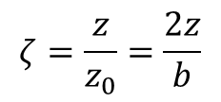
NLO with Focused Gaussian Beams
$$ζ=\frac{z}{z_{0}}=\frac{2z}{b}$$
For q-th Harmonic Generation:
q=3

Slide 34
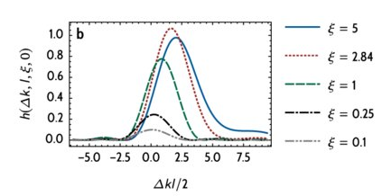
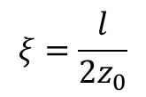

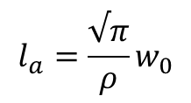
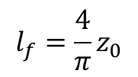
$$l_{f}={\frac{4}{π}z}_{0}$$
$$l_{a}={\frac{√π}{ρ}w}_{0}$$
$$ξ=\frac{l}{2z_{0}}$$
$$Δk=\frac{3.2}{l}$$

Slide 35
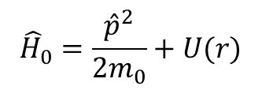
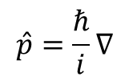
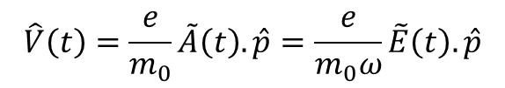

Quantum Mechanical Treatment
$${\hat{H}}_{0}=\frac{{\hat{p}}^{2}}{2m_{0}}+U(r)$$
$$\hat{p}=\frac{ℏ}{i}∇$$
Optical (dipole) Interaction:
Or A.p Interaction (for solids) :
$$\hat{V}\left(t\right)=\frac{e}{m_{0}}\tilde{A}\left(t\right).\hat{p}=\frac{e}{m_{0}ω}\tilde{E}\left(t\right).\hat{p}$$
$$\tilde{E}\left(t\right)=−\frac{d\tilde{A}\left(t\right)}{dt}$$
Recall:
Energy Eigenstates
Perturbation Theory:

Slide 36
Quantum Mechanical Treatment
System initially in the ground state (g)
Multiply each side from the left by u∗ and integrate the resulting equation over all space.

Slide 37
Quantum Mechanical Treatment
=
electric dipole transition moment.

Slide 38





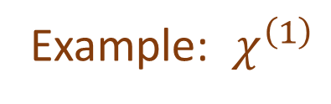





Quantum Mechanical Treatment
Example: $χ^{\left(1\right)}$
$${\tilde{P}}^{\left(1\right)}=N\left\langle {\tilde{p}}^{\left(1\right)}\right\rangle =ε_{0}χ^{\left(1\right)}E\left(ω_{p}\right)e^{−iω_{p}t}$$
$$ω_{mn}=ω_{mn}^{0}−iΓ/2$$
|m>
$$ω_{p}$$
$${−ω}_{p}$$
|g>
|g>
|g>
$$ω_{p}$$
$${−ω}_{p}$$
|g>
$$ω_{p}$$
$${−ω}_{p}$$
|m>
$${−ω}_{p}$$
$$ω_{p}$$
|m>
|m>
|g>
|g>

Slide 39



Quantum Mechanical Treatment
$$ω_{p}$$
$$ω_{q}$$
$$ω_{q}+ω_{p}$$
|g>
|m>
|g>
|m>
|n>
|n>
|g>
|n>
|m>
|g>
Far away from resonances:
Note: for $χ^{\left(2\right)}$, this requires states with mixed-parity (e.g. S+P) (non-centro-symmetry)

Slide 40
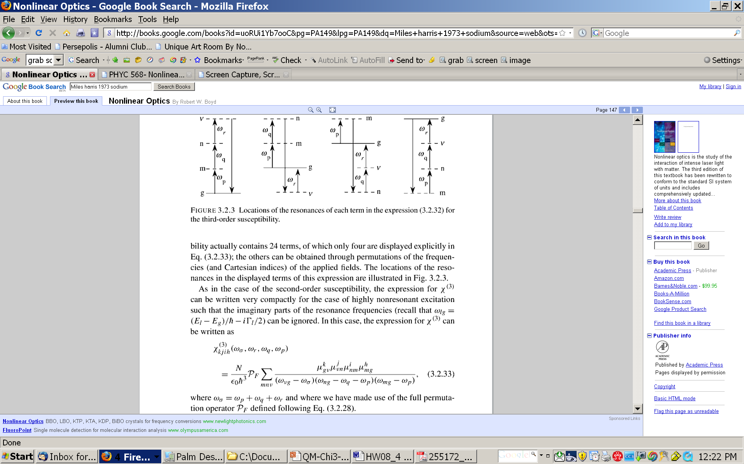




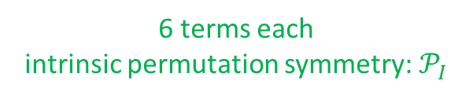

$$χ^{\left(3\right)}(ω_{σ}=ω_{p}+ω_{q}+ω_{r})$$
Sum-Frequency Generation (SFG), 3rd Harmonic Generation (THG),..
(a)
(b)
(c)
(d)
6 terms each
intrinsic permutation symmetry: $𝒫_{I}$
$$ω_{p}$$
$$ω_{q}$$
$$ω_{r}$$
$$ω_{σ}$$
(a)
(b)
(c)
(d)

Slide 41
(a)
(b)
(c)
(d)
(a)
(b)
(c)
(d)

Slide 42

Full Permutation Symmetry $𝒫_{F}$
When far enough from any resonances: $χ^{\left(N\right)}$is real
Example: THG in atomic media

Slide 43
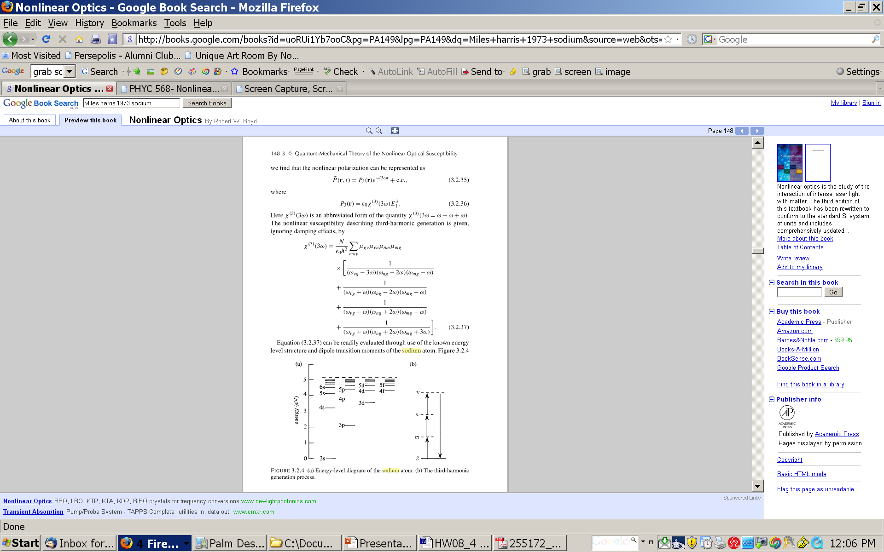
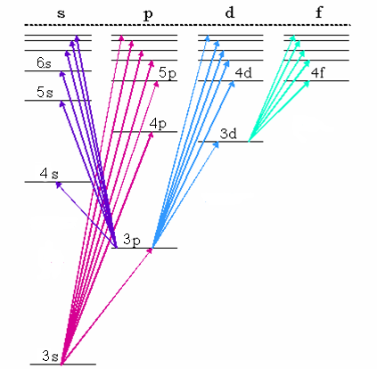
Na (Sodium)

Slide 44
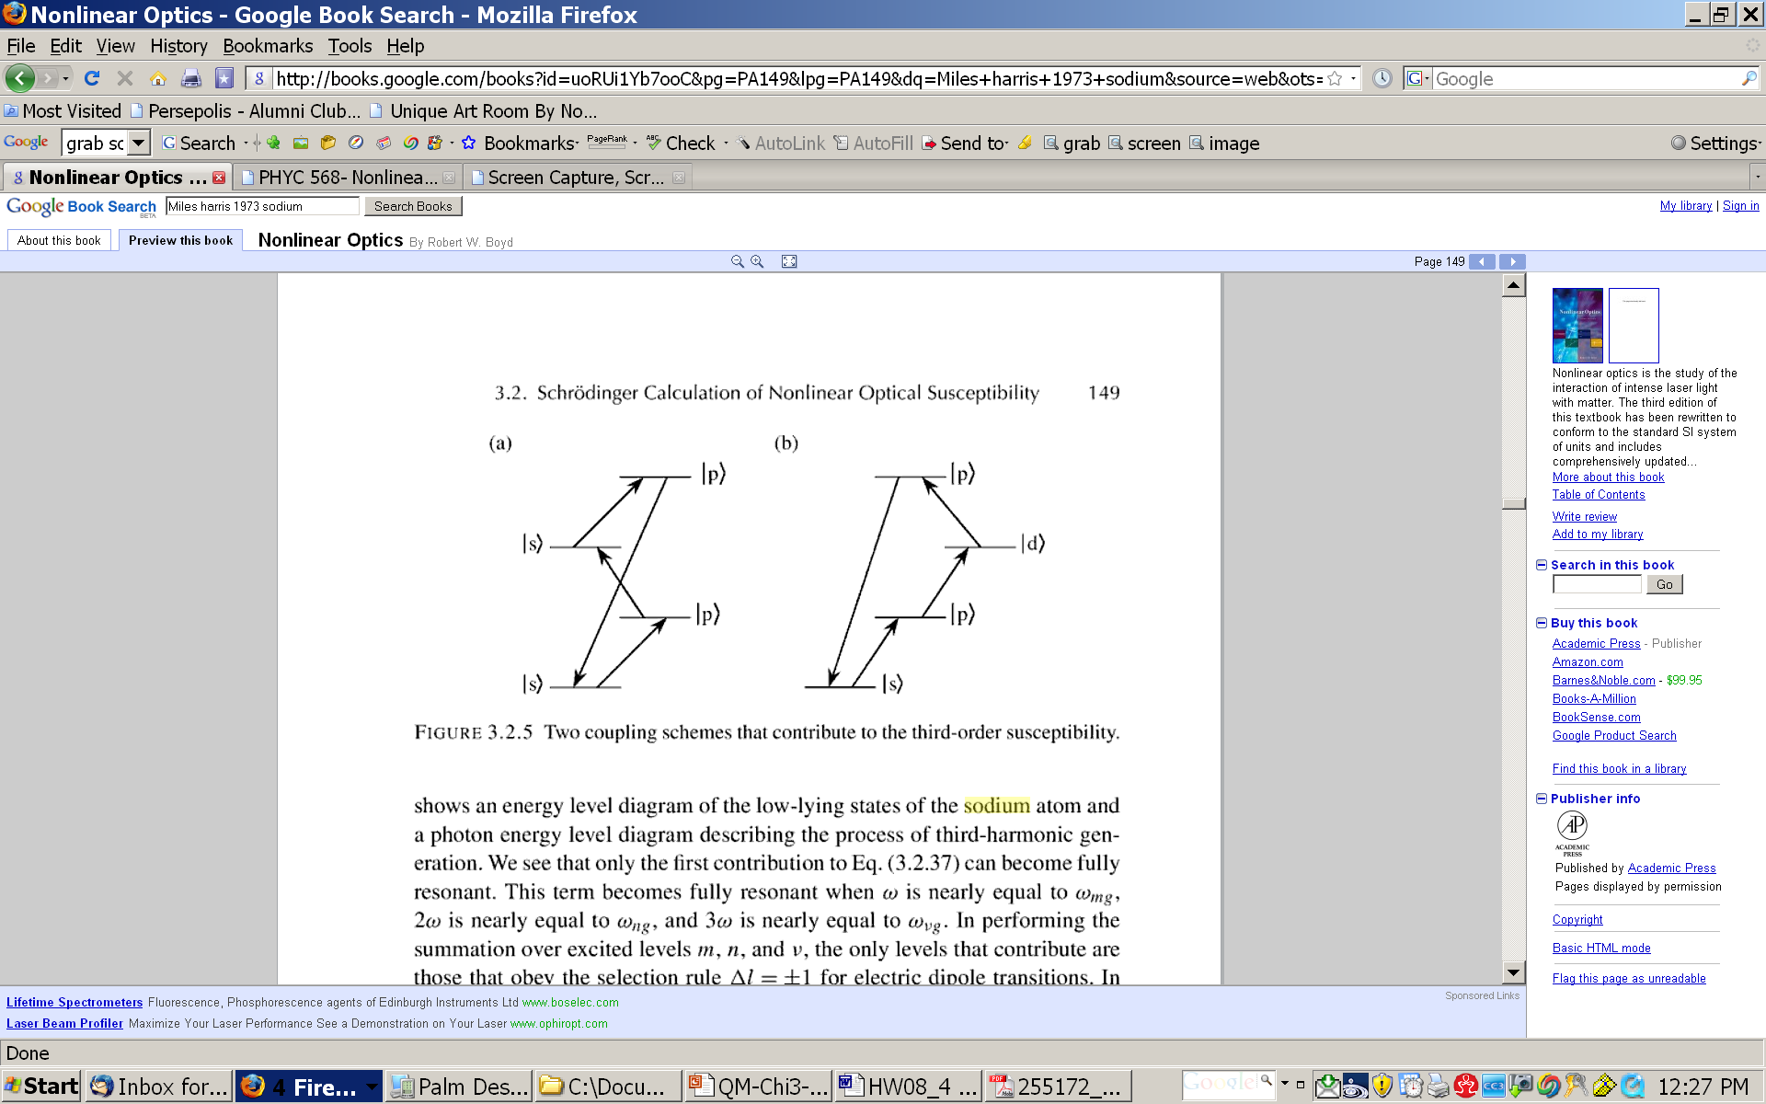

Slide 45
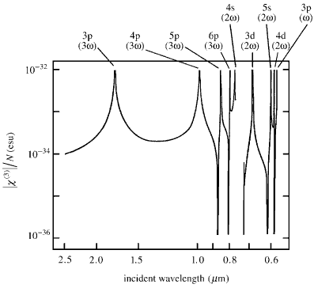
THG in Na-vapor

Slide 46

Other types of $χ^{\left(3\right)}$ (DFG, Kerr effect, …)
What are the consequences of Imaginary part of $χ^{\left(3\right)}$?

Slide 47








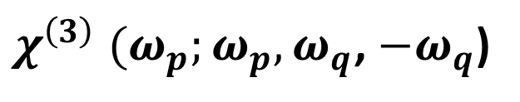









$$ω_{q}$$
Example:
$χ^{\left(3\right)} (ω_{p};ω_{p},ω_{q}$, ${−ω}_{q}$)
$$ω_{p}$$
|n>
|n>
|v>
$$ω_{q}$$
$$ω_{q}$$
$$ω_{q}$$
$$ω_{p}$$
|v>
|m>
$$ω_{q}$$
$$ω_{q}$$
|m>
|v>
|v>
$$ω_{p}$$
$$ω_{p}$$
$$ω_{q}$$
$$ω_{q}$$
|m>
|g>
|n>
|g>
$$ω_{p}$$
$$ω_{p}$$
$$ω_{p}$$
$$ω_{q}$$
|g>
|n>
|g>
$$ω_{p}$$
$$ω_{p}$$
|g>
|g>
|m>
6-terms each
|g>
|m>
|v>
|g>
|g>
|m>
|v>
|g>
|g>
|n>
|v>
|m>
|v>
$$ω_{q}$$
$$ω_{q}$$
$$ω_{p}$$
$$ω_{p}$$
|m>
|n>
|n>
|v>
|m>
|n>
|v>
|m>
|n>
|g>
|g>
|n>
|g>
No more 3-photon resonances
Only 1-photon and 2-photon resonances

Slide 48





|g>
|m>
|v>
|g>
|g>
|m>
|v>
|g>
|g>
|n>
|v>
|m>
|v>
$$ω_{q}$$
$$ω_{q}$$
$$ω_{p}$$
$$ω_{p}$$
|m>
|n>
|n>
|v>
|m>
|n>
|v>
|m>
|n>
|g>
|g>
|n>
|g>
$$ω_{r}={−ω}_{q}$$

Slide 49






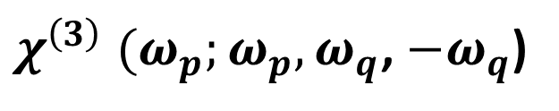
See: OSA Handbook
Sheik-Bahae and Hasselbeck
$$ω_{b}$$
$χ^{\left(3\right)} (ω_{p};ω_{p},ω_{q}$, ${−ω}_{q}$)
$$ω_{a}$$
Resonances
|n>
|n>
|m>
|v>
$$ω_{q}$$
$$ω_{p}$$
|v>
$$ω_{q}$$
$$ω_{q}$$
$$ω_{p}$$
$$ω_{q}$$
$$ω_{q}$$
$$ω_{q}$$
|m>
|m>
|m>
|g>
$$ω_{p}$$
$$ω_{p}$$
$$ω_{q}$$
$$ω_{q}$$
|m>
|v>
|v>
$$ω_{p}$$
$$ω_{p}$$
$$ω_{p}$$
$$ω_{p}$$
|n>
|g>
|n>
|g>
|g>
|g>
$$ω_{p}+ω_{q}=ω_{ng}$$
$$ω_{p}, ω_{q}=ω_{ng},ω_{νg}$$
$$ω_{p}+ω_{q}=ω_{ng}$$
$${−ω}_{p}+ω_{q}=ω_{ng}$$
2-photon
Raman-type
1-photon

Slide 50

See: OSA Handbook
Sheik-Bahae and Hasselbeck
$$ω_{b}$$
$$ω_{a}$$
$$n+iκ=n_{0}+Δn+\frac{ic}{2ω_{a}}(α_{0}+Δα)$$
Self-Phase Modulation
Cross-Phase Modulation
$$Δn\left(ω_{a}\right)=n_{2}\left(ω_{a};ω_{a}\right)I_{a}+2n_{2}\left(ω_{a};ω_{b}\right)I_{b}$$
Intensity dependent refractive index (Optical Kerr effect)
Chapter 4

Slide 51

Imaginary Part
$χ^{\left(3\right)} (ω_{p};ω_{p},ω_{q}$, ${−ω}_{q}$)
Also use the identity:

Slide 52






Also recall from Chap. 2:
$$\frac{dI_{1}}{dz}=−β_{11}I_{1}^{2}−{2β}_{12}I_{1}I_{2}$$
Two-photon absorption
$$β_{pq}=Im\left\{χ^{\left(3\right)} (ω_{p};ω_{p},ω_{q}\text{, }{−ω}_{q}\text{) }\right\}$$
$$ω_{b}$$
$$ω_{a}$$
$$ω_{b}$$
$$ω_{a}$$

Slide 53
Two-Photon Absorption Spectroscopy
S
linear absorption
not (dipole) allowed
hν/2
P
hν
hν/2
S

Slide 54
Two-photon Doppler-free spectroscopy of hydrogen atom
v
ν, k
ν, - k
2p_{3/2}
2s_{1/2}
RF
2p_{1/2}
(See HW#2)
243 nm
1s_{1/2}

Slide 57
1S-3S two-photon Spectroscopy

Slide 59
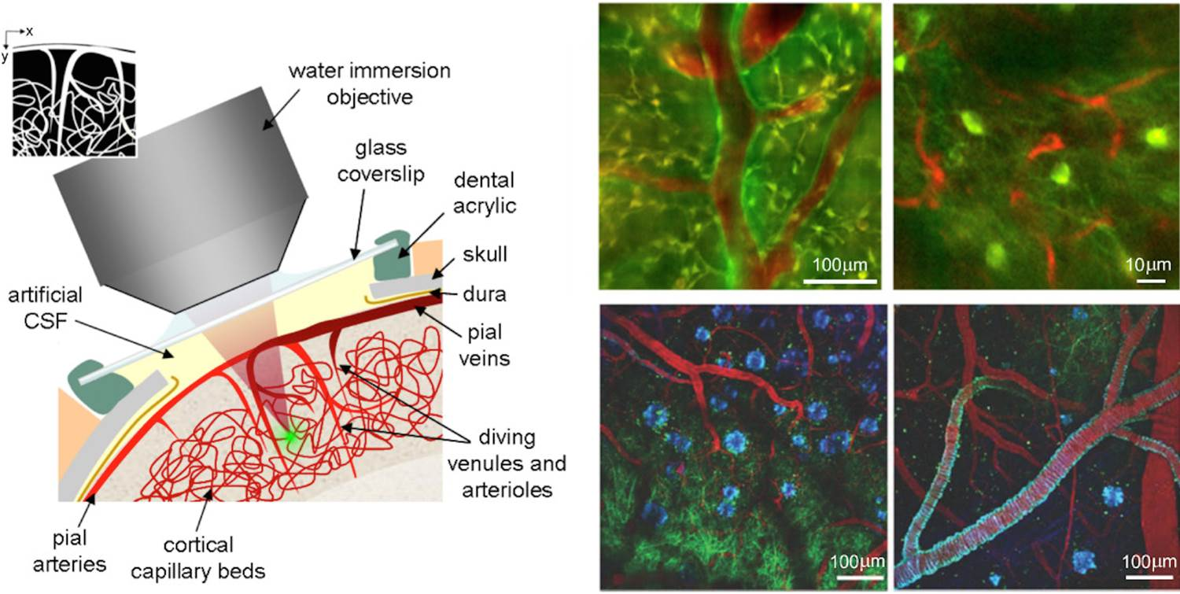
Example: 2-photon and 3–photon microscopy

Slide 60

Local-Field Effects
$${\tilde{E}}_{inc}$$

Slide 61



See: OSA Handbook
Sheik-Bahae and Hasselbeck
Chapter 4
Intensity dependent refractive index (Optical Kerr effect)
$$ω_{b}$$
$$n+iκ=n_{0}+Δn+\frac{ic}{2ω_{a}}(α_{0}+Δα)$$
$$ω_{a}$$
Self-Phase Modulation
Cross-Phase Modulation
$$Δn\left(ω_{a}\right)=n_{2}\left(ω_{a};ω_{a}\right)I_{a}+2n_{2}\left(ω_{a};ω_{b}\right)I_{b}$$

Slide 62



See: OSA Handbook
Sheik-Bahae and Hasselbeck
$$ω_{b}$$
${Re\{χ}^{\left(3\right)} (ω_{p};ω_{p},ω_{q}$, ${−ω}_{q}$)}
$$ω_{a}$$
Resonances
|n>
|m>
|v>
$$ω_{q}$$
$$ω_{q}$$
$$ω_{p}$$
$$ω_{q}$$
$$ω_{q}$$
$$ω_{p}$$
|m>
|v>
|m>
|v>
|g>
$$ω_{p}$$
$$ω_{p}$$
$$ω_{q}$$
$$ω_{q}$$
$$ω_{p}$$
$$ω_{p}$$
|n>
|g>
|n>
|g>
|g>
$$ω_{p}+ω_{q}=ω_{ng}$$
$${−ω}_{p}+ω_{q}=ω_{ng}$$
$$ω_{p}, ω_{q}=ω_{ng},ω_{νg}$$

Slide 63
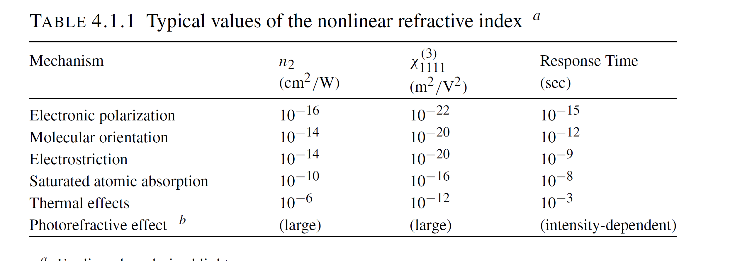

Slide 64
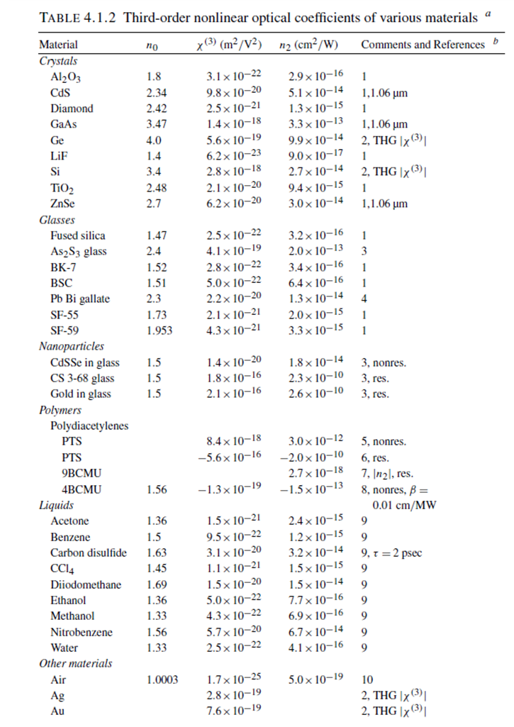

Slide 65
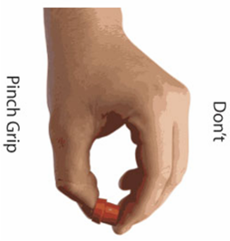
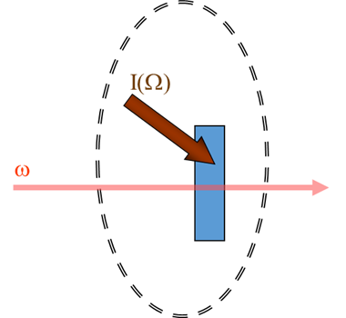
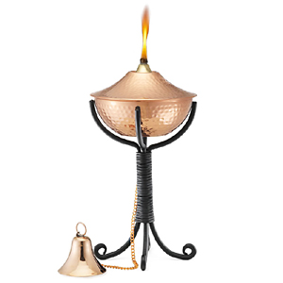

Optical Kerr Effect ($n_{2})$in Semiconductors
α
ω
n
ω

Slide 66
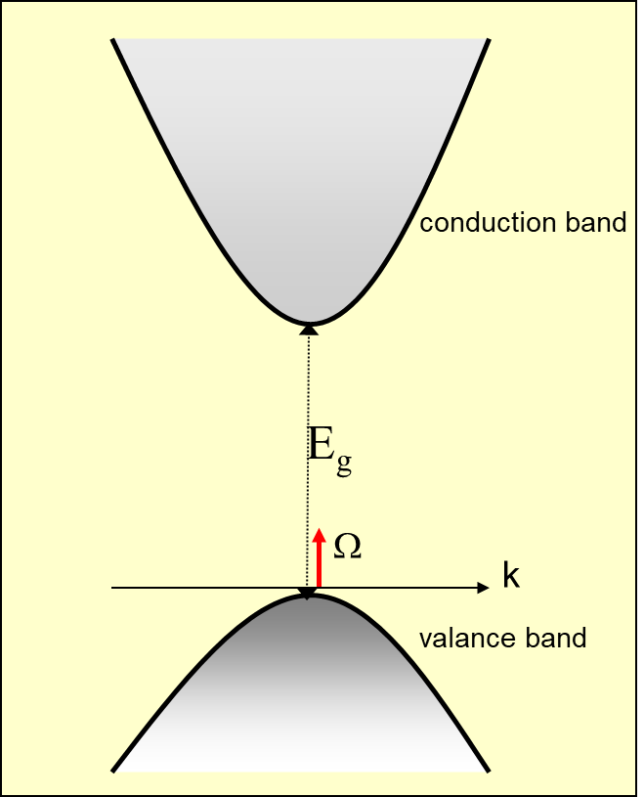
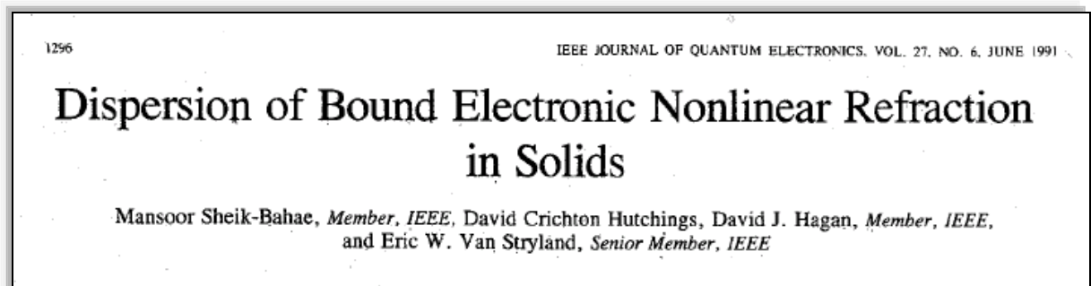

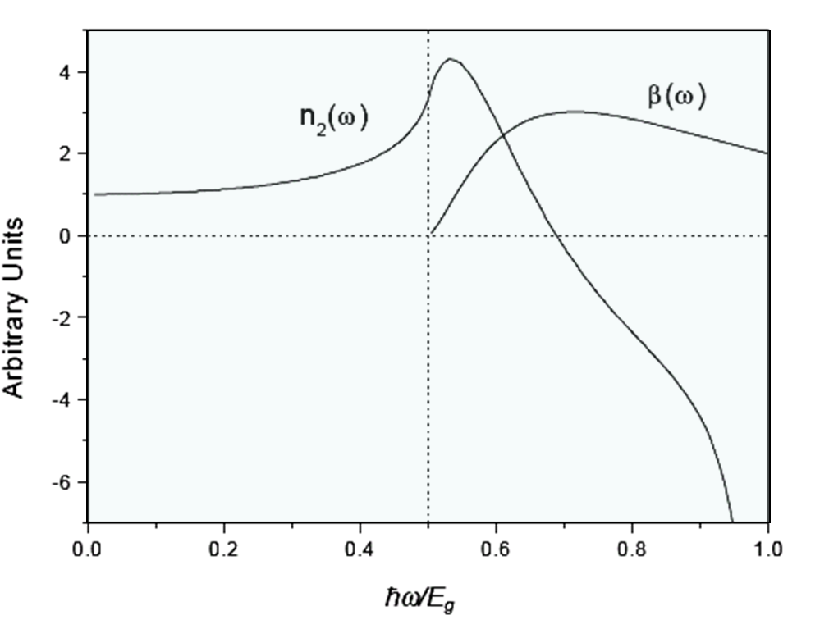

Optical Kerr Effect ($n_{2})$in Semiconductors
Note (even if Ω→ω):
Need

Slide 68
In Boyd (2,3,4th edition)
More Complete Version

