Slide 1
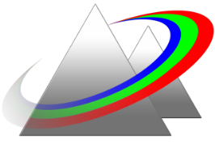

Midterm Review
Optical Science & Engineering
PHYS/ECE 464
Laser Physics I
10/24/2022
Mansoor Sheik-Bahae
Department of Physics and Astronomy
University of New Mexico (UNM), Albuquerque, NM, USA

Slide 2










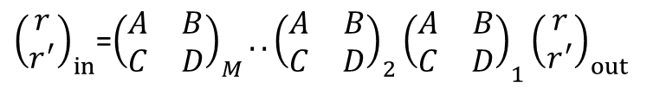




Ray Tracing – Geometric Optics
${\left(\begin{matrix}r \\ r^{′}\end{matrix}\right)}_{in}$
${\left(\begin{matrix}r \\ r^{′}\end{matrix}\right)}_{out}$
$$\left(\begin{matrix}A & \\ & D\end{matrix}\right)$$
${\left(\begin{matrix}r \\ r^{′}\end{matrix}\right)}_{in}$=$\left(\begin{matrix}A & B \\ C & D\end{matrix}\right){\left(\begin{matrix}r \\ r^{′}\end{matrix}\right)}_{out}$
$$\left(\begin{matrix}A & B \\ C & D\end{matrix}\right)$$
${\left(\begin{matrix}r \\ r^{′}\end{matrix}\right)}_{in}$
${\left(\begin{matrix}r \\ r^{′}\end{matrix}\right)}_{out}$
$$\left(\begin{matrix}A & \\ & D\end{matrix}\right)$$
$$\left(\begin{matrix}A & \\ & D\end{matrix}\right)$$
$$\left(\begin{matrix}A & \\ & D\end{matrix}\right)$$
$${\left(\begin{matrix}A & B \\ C & D\end{matrix}\right)}_{1}$$
$${\left(\begin{matrix}A & B \\ C & D\end{matrix}\right)}_{2}$$
o o
$${\left(\begin{matrix}A & B \\ C & D\end{matrix}\right)}_{M}$$
${\left(\begin{matrix}r \\ r^{′}\end{matrix}\right)}_{in}$=${\left(\begin{matrix}A & B \\ C & D\end{matrix}\right)}_{M}..{{\left(\begin{matrix}A & B \\ C & D\end{matrix}\right)}_{2}\left(\begin{matrix}A & B \\ C & D\end{matrix}\right)}_{1}{\left(\begin{matrix}r \\ r^{′}\end{matrix}\right)}_{out}$
$${\left(\begin{matrix}A & B \\ C & D\end{matrix}\right)}_{T}$$

Slide 3
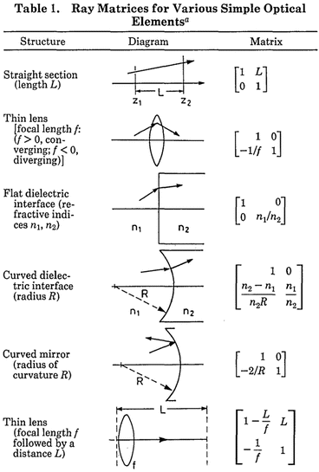

Slide 4
Ray Tracing in Optical cavities

Slide 5
Stability

Slide 6
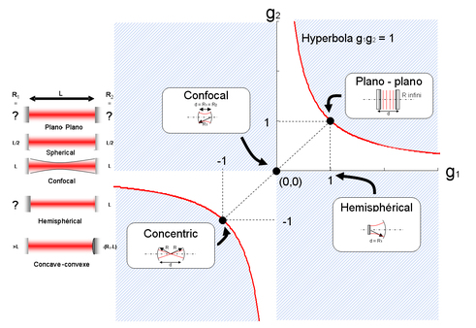



Stability: two-mirror cavity
$R_{1}/R_{2}$=1
$${(g}_{2}−1)/(g_{1}−1)=R_{1}/R_{2}$$
$$g_{2}={(R}_{1}/R_{2})g_{1}+1−R_{1}/R_{2}$$

Slide 7
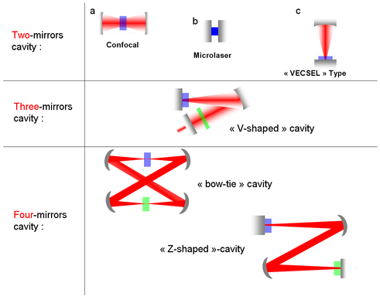
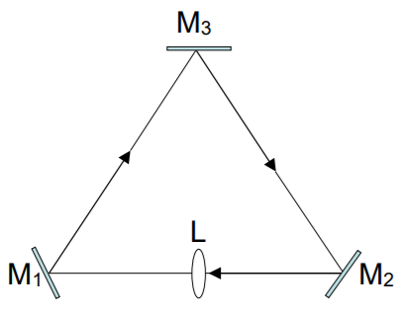
Other Cavities, ….

Slide 8
Astigmatism
Example:

Slide 9
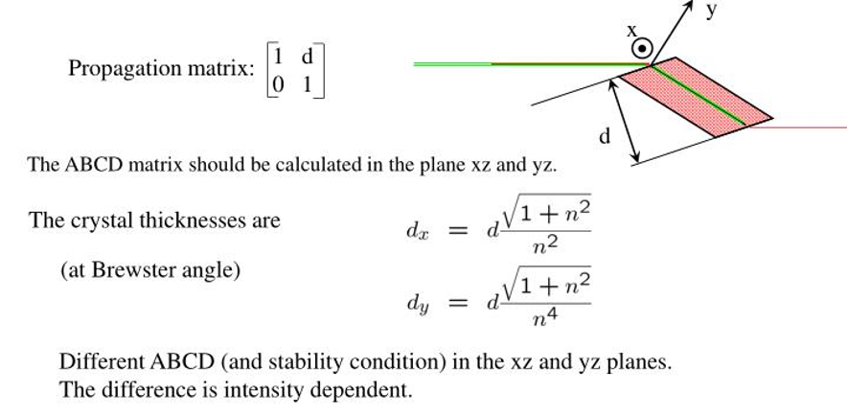
Astigmatism

Slide 10
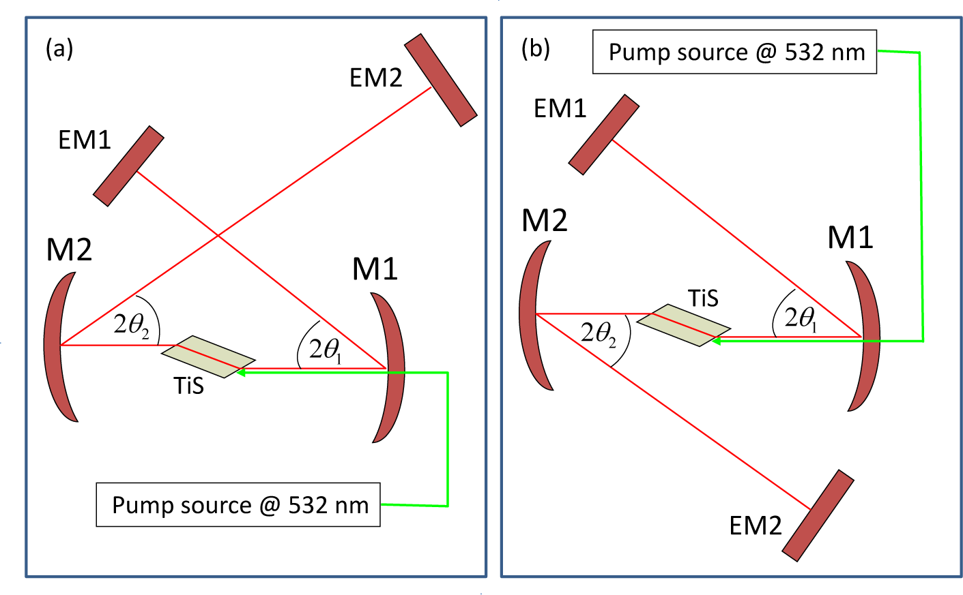
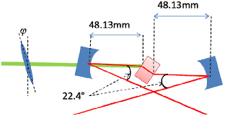
Example: Astigmatism Compensation

Slide 11
Phase front modulation by a thin lens

Slide 12
Ch. 5: Gaussian Optics
Slowly-Varying Envelope Approximation (SVEA)

Slide 13

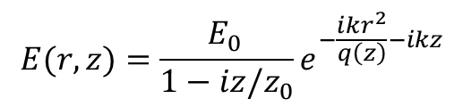
Ch. 5 Gaussian Beam
$$i≡j$$
$$E(r,z)=\frac{E_{0 }}{1−iz/z_{0}}e^{−\frac{ikr^{2}}{q\left(z\right)}−ikz}$$
Rayleigh Distance, Diffraction Length

Slide 14
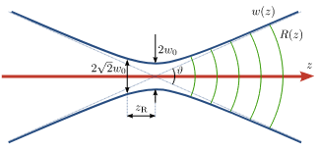
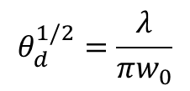
Gaussian Beams
$$θ_{d}^{1/2}=\frac{λ}{πw_{0}}$$
Half-angle divergence angle

Slide 15
Hermite-Gaussian Modes

Slide 16
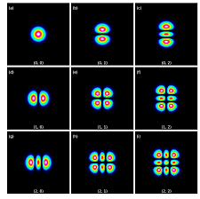
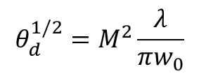
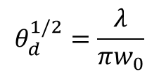
Hermite-Gaussian Modes
Define M² as a measure of the beam quality:
$$θ_{d}^{1/2}=M^{2}\frac{λ}{πw_{0}}$$
Example: TEM_{mp} has
M² = 2m+1 along x
M² = 2p+1 along y
A perfect TEM₀₀ mode has M²=1
$$θ_{d}^{1/2}=\frac{λ}{πw_{0}}$$

Slide 17
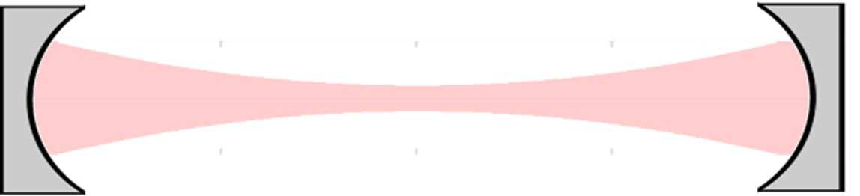




ABCD Law and Gaussian Beams
$q_{1}$
$q_{2}$
$$\left(\begin{matrix}A & \\ & D\end{matrix}\right)$$
$$\left(\begin{matrix}A & B \\ C & D\end{matrix}\right)$$

Slide 18
Gaussian Beams in Optical Cavities

Slide 19

Gaussian Beams in Optical Cavities
Phase-front Curvature Matches the End-Mirrors’ Radius of Curvature
$$d$$

Slide 20
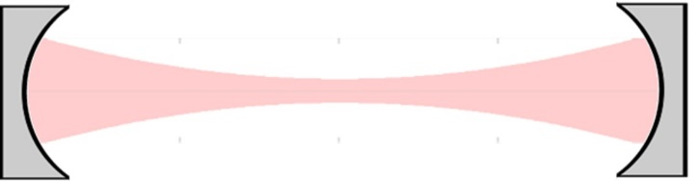
USING ABCD Matrices
Starting point (z=z₁)

Slide 21
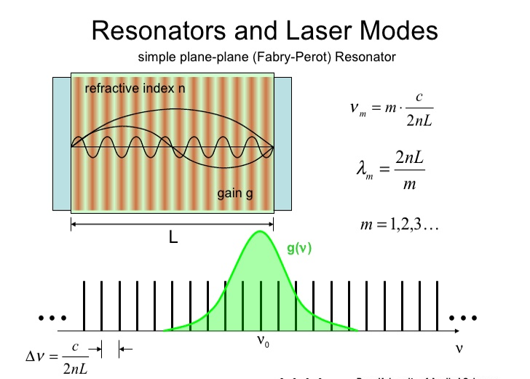
Resonant Optical Cavities (Ch. 6)

Slide 22




Resonant Optical Cavities (Ch. 6)
$$R_{1,2}={\left|Γ_{1,2}\right|}^{2}$$
$$θ=kd$$
Resonances
$$θ=qπ$$
$$q≡integer$$

Slide 23
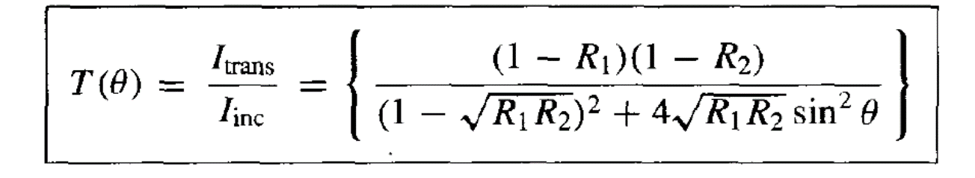
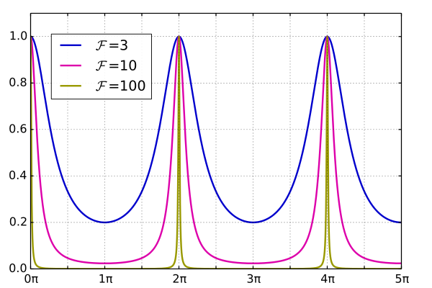











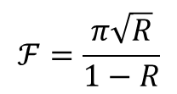
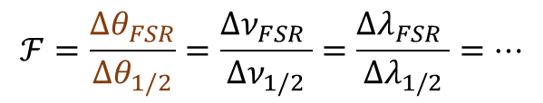

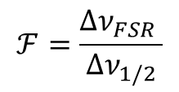
Fabry-Perot Resonances
$$θ=kd$$
$$θ=qπ$$
$$q≡integer$$
$$ν_{q}=q\frac{c}{2nd}$$
$$ν_{q+1}−ν_{q}=\frac{c}{2nd}≡{Δν}_{FSR}$$
$${Δν}_{FSR}$$
$$Q=q\frac{{Δν}_{FSR}}{{Δν}_{1/2}}$$
$$ℱ=\frac{{Δν}_{FSR} }{{Δν}_{1/2}}$$
Finesse
$$ν_{q}$$
$$ℱ=\frac{π\sqrt{R}}{1−R}$$
$$R=\sqrt{R_{1}R_{2}}$$
$${Δν}_{1/2}$$
$${Δθ}_{1/2}$$
$$ℱ=\frac{{Δθ}_{FSR}}{{Δθ}_{1/2}}=\frac{{Δν}_{FSR} }{{Δν}_{1/2}}=\frac{{Δλ}_{FSR} }{{Δλ}_{1/2}}=…$$
$$θ=kd$$

Slide 24






Scanning F-P Interferometer
d
$$λ_{0}$$
$$δd$$
$$λ_{0}/2n$$
$$δd$$
$$Δλ_{FSR}$$
$$λ$$

Slide 25



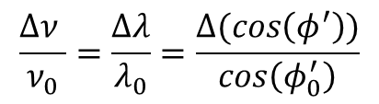


Oblique Incidence
d
$$θ=kd cos(φ′)$$
$$φ$$
$φ′$= internal angles
R₁
R₁
$$\frac{Δν }{ν_{0}}=\frac{Δλ}{λ_{0}}=\frac{Δ(cos\left(φ^{′}\right))}{cos\left(φ_{0}^{′}\right)}$$
$$φ$$
$$≈\frac{Δφ^{′2}}{2}$$
n
Fabry-Perot Etalon
R
R

Slide 26


Photon Lifetime
$$S=R_{1}R_{2}$$
Survival Factor (passive cavity)
$τ_{p}=\frac{Q}{ω_{0}}=\frac{ℱ}{2πΔν_{FSR}}$=$\frac{1}{2πΔν_{1/2}}$

Slide 27
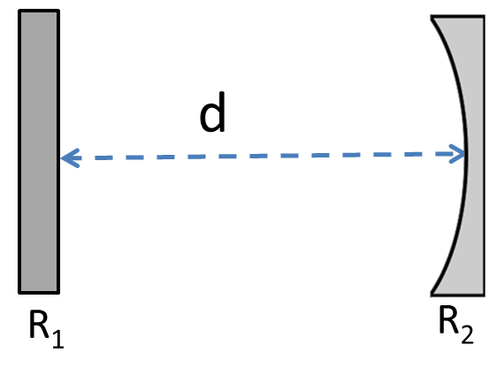
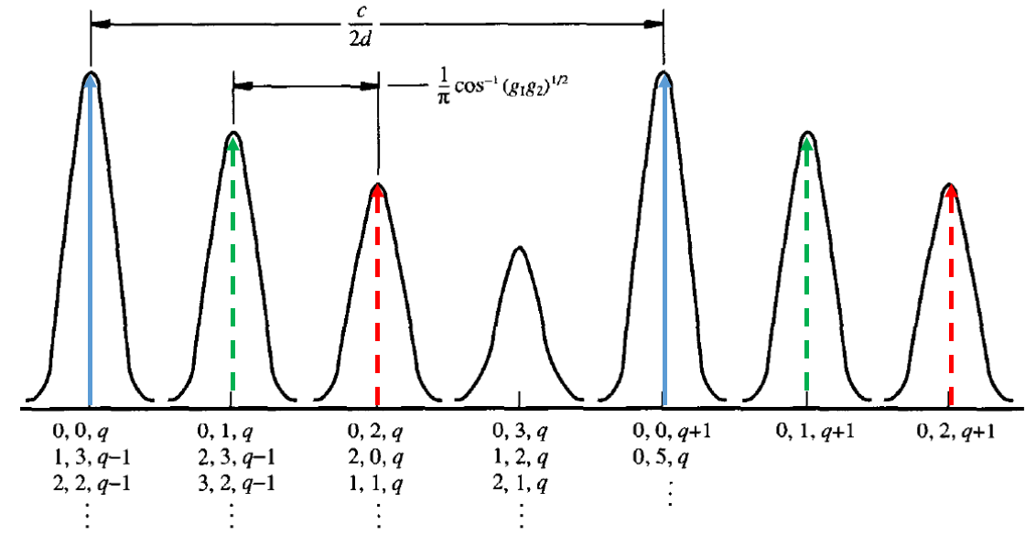
Resonance of Hermite-Gaussian Modes
Example:
More generally (for a 2-mirror linear cavity):

Slide 28
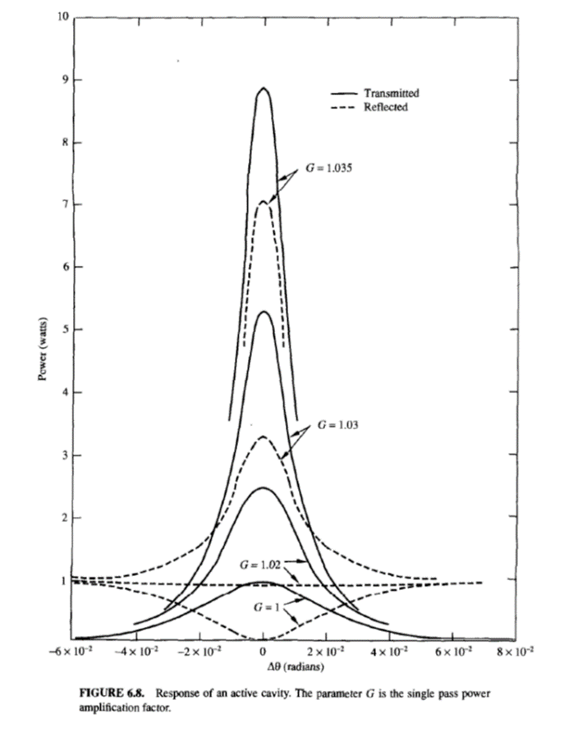



Fabry-Perot with Gain/Loss
$$G_{0}>1 Gain$$
$$G_{0}=A_{0}<1 Loss$$
$$G_{0}^{2}S=1$$
Oscillation (Laser) Threshold
$S=R_{1}R_{2}$… = Survival Factor

Slide 29
Ch. 7 Light Matter Interaction
ω₀
+
X
-
Classical Electron Model ( Lorentz Model)
E
Normalized plot of n_{r}-1 and n_{i} versus ω−ω₀

Slide 30

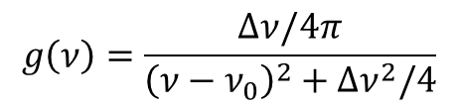

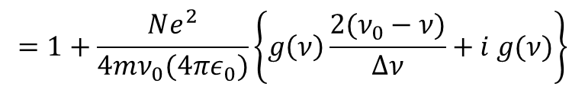



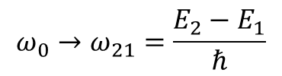
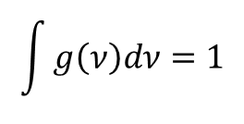
From classical to quantum mechanical approach:
$$=1+\frac{Ne^{2}}{4mν_{0}(4πε_{0})}\left\{g\left(ν\right)\frac{{2(ν}_{0}−ν)}{Δν}+i g(ν)\right\}$$
$$g\left(ν\right)=\frac{Δν/4π}{{\left(ν−ν_{0}\right)}^{2}+Δν^{2}/4}$$
$$\int{g\left(ν\right)dν=1}$$
Absorption or Gain coefficient: $α=−γ=\frac{4π}{λ}n_{i}$
QM result:
N₂
$$E_{2}$$
$$E_{21}$$
N₁
$$E_{1}$$
$$ω_{0}→ω_{21}=\frac{E_{2}−E_{1}}{ℏ}$$
$f_{12}$= oscillator strength

Slide 31
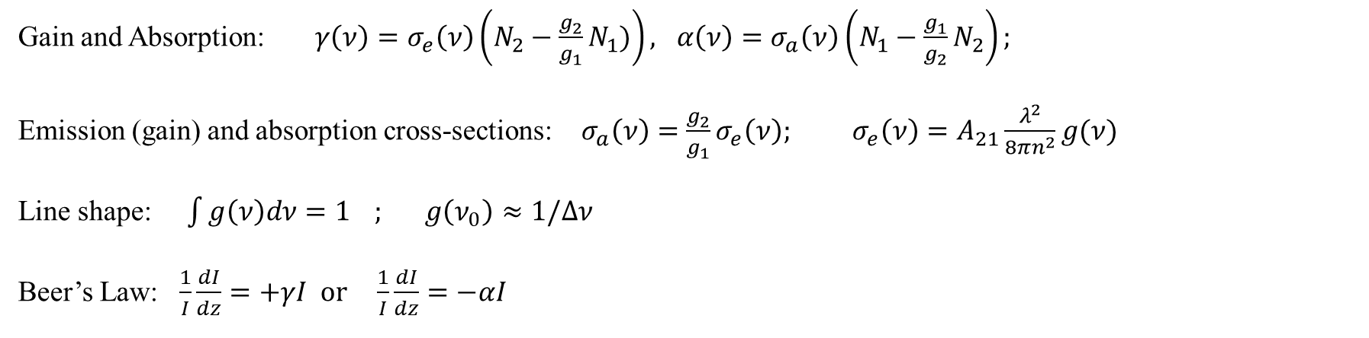
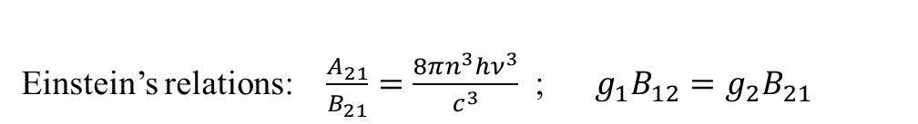
Einstein’s Detailed Balance Approach
BB
N₂
Einstein’s relations: $\frac{A_{21}}{B_{21}}=\frac{8πn^{3}hν^{3}}{c^{3}}$ ; $g_{1}B_{12}=g_{2}B_{21}$
A₂₁
B₁₂
B₂₁
N₁
Gain and Absorption: $γ\left(ν\right)=σ_{e}\left(ν\right)\left(N_{2}−\frac{g_{2}}{g_{1}}N_{1})\right), α\left(ν\right)=σ_{a}\left(ν\right)\left(N_{1}−\frac{g_{1}}{g_{2}}N_{2}\right);$
Emission (gain) and absorption cross-sections: $σ_{a}\left(ν\right)=\frac{g_{2}}{g_{1}}σ_{e}\left(ν\right); σ_{e}\left(ν\right)=A_{21}\frac{λ^{2}}{8πn^{2}}g(ν)$
Line shape: $\int{g\left(ν\right)dν=1} ; g\left(ν_{0}\right)≈1/Δν$
Beer’s Law: $\frac{1}{I}\frac{dI}{dz}=+γI or \frac{1}{I}\frac{dI}{dz}=−αI$

Slide 32
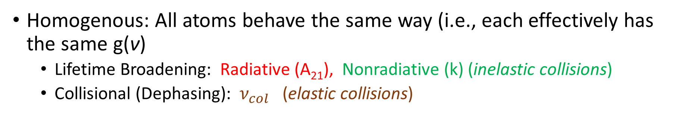
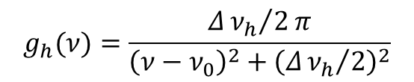
Lineshape and Broadening Mechanisms
Homogenous: All atoms behave the same way (i.e., each effectively has the same g(ν)
  Lifetime Broadening: Radiative (A₂₁), Nonradiative (k) (inelastic collisions)
  Collisional (Dephasing): $ν_{col}$ (elastic collisions)
N₂
A₂+k₂
$$g_{h}(ν)=\frac{Δ{ν_{h}}/2π}{{\left(ν−ν_{0}\right)}^{2}+{\left(Δ{ν_{h}}/2\right)}^{2}}$$
N₁
A₁+k₁

Slide 33
Lineshape and Broadening Mechanisms
Inhomogeneous Broadening: Each atom or molecule (or cluster of atoms and molecules) has different g(ν) due to its environment.
Inhom

Slide 34
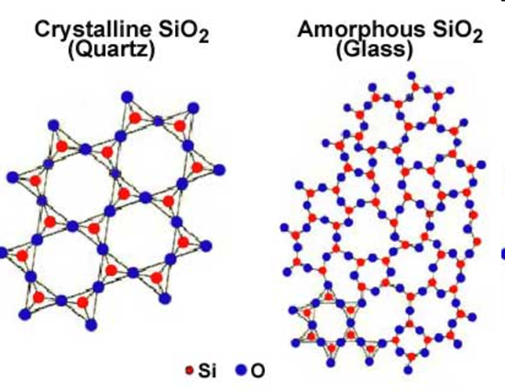
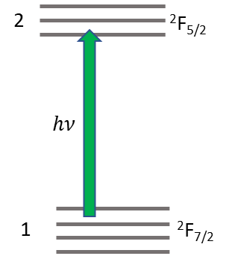
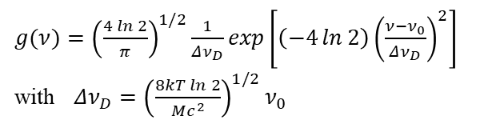
Lineshape and Broadening Mechanisms
  Doppler (Gas Lasers)
  Isotope
  …...
  Stark Splitting (Solid-State Lasers)
$g(ν)={\left(\frac{4\ln{2}}{π}\right)}^{1/2}\frac{1}{Δν_{D}}\exp\left[\left(−4\ln{2}\right){\left(\frac{ν−ν_{0}}{Δν_{D}}\right)}^{2}\right]$
with $Δν_{D}={\left(\frac{8kT\ln{2}}{Mc^{2}}\right)}^{1/2}ν_{0}$
Yb³⁺

